Slide 1
PAQAA Governance and functions
December 4, 2025

Slide 2
How We Got Here
Third phase of the HAQAA Initiative
Supporting the PAQAF implementation
CESA 2025
African Union Vision 2063

Slide 3
PAQAA as a driver of PAQAF
African Standards and Guidelines for Quality Assurance (ASG-QA)
AQRM for institutional evaluation
Quality Assurance capacity building trainings for National Quality Assurance Agencies
Pan-African Quality Assurance and Accreditation Agency (PAQAA)
HAQAA
African Academic Credit Transfer System
2016
AU adopted PAQAF
2019-2023
Technical Working Group
appointed by AU under HAQAA2
2023
First proposal for PAQAA structure presented to AU
PAQAF
Addis Recognition Convention
CESA 25/ First Ten-Year Implementation Plan for Agenda 2063
African Continental Qualifications Framework (ACQF)
TUNING/HAQAA
UNESCO
Recommendations to the AUC on the establishment of the Pan-African Quality Assurance and Accreditation Agency (PAQAA)
Produced by the Technical Working Group (TWG) for the Set-Up of the PAQAA, appointed and financed by the HAQAA2 Initiative and endorsed by the AUC
SIFA

Slide 4

The ASG-QA
*A continental reference document: based on exisiting standards at different levels in Africa and
internationally, targeting both IQA and EQA
*New feature: National quality bodies assuring their own quality = transparency in QA procedures

Slide 5
Why this matters
Trust and recognition (within and outside Africa)
Stronger national QA systems
Harmonised regional QA frameworks
One continental voice for African QA in higher education

Slide 6
HAQAA3 Technical assistance to PAQAA
(2023-2028)
Transversal Work Area – Policy and Capacity for Regional Integration
Work Area 1: Piloting the African Credit Transfer System - ACTS
Work Area 2: African HE Data Capacity
Work Area 3: Towards PAQAA/ PAQAA
Consultations
Support for a Technical Unit and ‘PAQAA Advisors’
Agency reviews, and consultancy visits against the ASG-QA (30)
African pool of external reviewers and students trained
EQA online training
Supporting interim governance structure, statutes drafting and sustainability model
Work Area 4: IQA/EQA Training and Capacity building

Slide 7
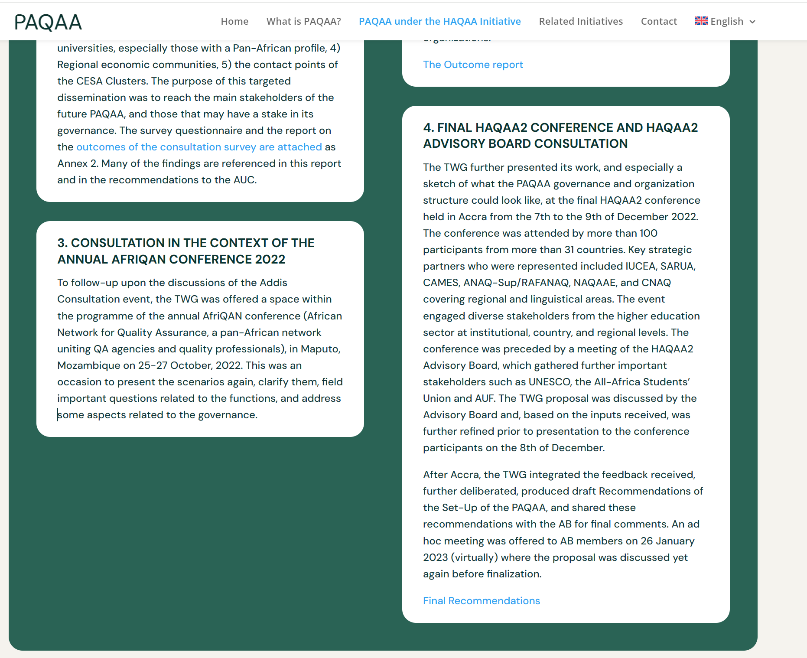

PAQAA website as a repository of its history

Slide 8
2024: Regional hybrid consultations
Western/Central Africa
Yaoundé – May 2024
Eastern Africa
Juba – July 2024
Southern Africa
Mauritius- August 2024
Northern Africa
Cairo – November 2024
Stakeholders Validation Meeting - online
June 30, 2025
Final PAQAA stakeholders validation report
4 reports
Recommendations on PAQAA governance and functions
Available on the HAQAA website
The events gathered a total of 110 African key actors, targeting QA councils, ministries and major stakeholders such as university networks and QA networks

Slide 9
Report: Main recommendations
Legal framework
  Explore renaming the PAQAA to better reflect its current functions and avoid confusion – Pan African Quality Assurance Alliance
Governance structure
  Launch an interim governance body with national membership and clearly defines ToR
Functions and phases
  Focus on initial, non-controversial functions: external reviews, capacity building, creation of a register, ASG-QA promotion and revision

Slide 10
The role of AU Member states: ministries and QAA
Validate recommendations
Endorse way forward
Spread the word (ASG-QA, PAQAA, PAQAF)
Be part of the Interim Council

Slide 11
Interim Council: What to expect
Voluntary affiliation of countries, represented through their responsible ministry or national QA agency
Support and participation of regional associations and organizations with a direct stake in QA and an afiliation to Member States
Minimum quota from each African region
Clear ToR clarifying roles and responsibilities
All major documents in ENG, FR, PT
Commitment to endorsing a formal legal status and statutes/financial model by the time HAQAA3 concludes (March 2028)

Slide 12
Interim Council status
Expressions of interest already sent to the African Union
Benin, Cabo Verde, Egypt, Guinea, Kenya, Liberia, Mauritania, Mauritius, Rwanda, Senegal, Seychelles, and South Sudan
Expected soon
The Gambia, Morocco, Malawi, Moçambique, Nigeria
Agencies undergoing an evaluation that could become part (communicate via diplomatic channels to the AUC):
Algeria, Angola, Botswana, Burkina Faso, RCA, Chad, Gabon, Côte d'Ivoire, Lesotho, Namibia, Tunisia

Slide 13
Next steps
AU Call for participation
Interim Council (Alliance governing structure)
September 2025
Interim Council convened: First virtual meeting
December 2025
Drafting statutes
(PAQAA Advisors- reporting to interim Council)
First quarter 2026 2025
Interim Council
in-person meeting
May 2026
Timeline 2025-2026

Slide 14

THANK YOU
MERCI
OBRIGADA
ASANTE SANA
Shaping the future of QA in Africa
More information: www.haqaa3.obreal.org

