Slide 1
African Credit Transfer System
(ACTS)

Slide 2
HAQAA3 | ACTS PILOT PHASE
Module 1 at a Glance
This module explores what academic credits are, how they function within curricula, how African and European experiences with credit system reform have evolved, and what all of this means for the practical use of ACTS at the institutional level.
Agenda
General presentation divided into 3 sections (40 minutes)
  Section 1 — Academic Credits: Concept, Workload and the ACTS Framework
  Section 2 — History and Evolution of Academic Credit Systems
  Section 3 — Translating Curricula into ACTS: A Practical Pathway
Work group session (40 Minutes)
Presentation of the results of group discussion (30 Minutes)
Conclusion (10 Minutes)
MODULE 1
Academic Credits
and Curricula

Slide 3
SECTION 1
Academic Credits: Concept, Workload
and the ACTS Framework

Slide 4
What is an Academic Credit?
INPUT-BASED LOGIC
OUTPUT-BASED LOGIC (ECTS & ACTS)
Input-based logic
Measures time the teacher spends teaching (contact hours).
Credits reflect teaching provision, not learning achievement.
Common in Carnegie-derived systems.
Measures total effort the student invests to achieve defined learning outcomes.
Credits reflect student workload. Shifts focus to the learner.
Four functions of academic credits
Progression tracking
Certifies completion of required programme portions
Workload communication
Signals how demanding a course is in terms of student effort
Mobility facilitation
Provides a common currency to compare work across institutions — primary ACTS function
Quality signalling
In some systems, signals academic level or rigour (ACTS works best alongside QA frameworks)

Slide 5
Credits and Learning Outcomes: The Essential Connection
Credits should reflect not just time invested, but learning achieved.
Learning outcomes make recognition more transparent — institutions can assess relevance of prior learning.
Tuning methodology makes this connection operational: programme-level and course-level outcomes expressed as competences.
Constructive Alignment (Biggs, 1999) — applied to the credit dimension
Vertical coherence
Horizontal coherence
Workload coherence
Every learning outcome is covered by at least one activity and one assessment.
Activities and assessments are aligned — students practise what they are assessed on.
Total hours required are consistent with the credit value declared.
Key insight: A credit is a container. What matters for recognition is what is inside: the learning outcomes, the level of study, and the academic context. ACTS provides the container; curricula design and learning outcomes specification fill it with meaning.

Slide 6
Student Workload Components & the ACTS Credit Reference Value
Scheduled Learning
& Teaching
Guided Independent
Study
Assessment Preparation
& Completion
Lectures, seminars, tutorials, lab sessions, field work, online synchronous classes
Assigned readings, problem sets, online modules, case study preparation, group project work
Exam revision, essay writing, project completion, presentation preparation, portfolio assembly
ACTS Credit Reference Value
1 ACTS credit =
20 to 25 hours of total student workload
60 ACTS credits
= 1 full academic year
≈ 1,200 to 1,500 hours
The 20–25 hour range acknowledges variation in institutional contexts, disciplines and delivery modes.
National calibration: countries may adopt a specific point within the range for NQF consistency.
Aligned with ECTS standard to facilitate international recognition under the Addis Convention.

Slide 7
ACTS: Design Principles and What Makes It Distinctive
1
Voluntary & Cooperative
2
Continental Reference, not Uniformity
ACTS is not imposed as a regulatory obligation. Institutions use it because they see value in the shared reference framework.
ACTS does not require all African institutions to adopt identical systems. It provides a common reference point against which different national definitions can be mapped.
3
Compatibility over Replacement
4
Trust-building through Use
ACTS explicitly recognises existing regional systems (EACATS, CAMES, SADCQF) and seeks articulation with them, not absorption.
The credibility of ACTS grows through practice. Each successful credit transfer builds the institutional trust that makes the next transfer easier.

Slide 8
SECTION 2
History and Evolution of Academic Credit Systems

Slide 9
From Carnegie to ECTS: Two Logics of Credit
Carnegie Unit (USA, 1906)
ECTS (Europe, 1988/1999)
Designed as an administrative instrument for pension eligibility — not as a measure of learning.
1 credit = 1 hour of classroom instruction/week over ~15 weeks (contact hours only).
Input-based and teacher-centred: measures time in the classroom.
Its legacy is still visible in institutions that define credit value primarily by lecture hours.
Carnegie Foundation itself has called for replacement with outcome-based measures.
Student-centred: credits measure what the student does, not what the teacher does.
1 ECTS = 25–30 hours of total student workload (contact + independent + assessment).
60 ECTS credits = one full academic year ≈ 1,500–1,800 hours.
Credits must be referenced to learning outcomes and their assessment.
Adopted by 50+ countries; primary model for ACTS and other regional systems.
→

Slide 10
Comparative Overview: Carnegie Unit, ECTS and ACTS
Feature
Carnegie Unit
ECTS
ACTS
Origin
USA, 1906
Europe, 1988/1999
Africa, 2000s–present
What is measured
Teacher contact hours
Total student workload
Total student workload
1 credit =
~1 h/week contact (15 weeks)
25–30 h total workload
20–25 h total workload
Full academic year
Variable (30–36 credits)
60 credits
60 credits
Learning Outcomes linkage
Not required
Required
Required
Design logic
Input-based
Output-based
Output-based
Regional scope
North America & influenced systems
50+ countries (Europe)
Pan-African framework

Slide 11
The Development of ACTS: From Tuning Africa to HAQAA3
Tuning Africa
2011–2015
HAQAA1
2015–2018
HAQAA2
2018–2022
HAQAA3
2023–present
Adapted Tuning methodology for Africa. Piloted learning outcome-based curriculum design in 5 disciplines. Established conceptual foundation for outcome-referenced credit allocation.
Developed the Pan-African Quality Assurance & Accreditation Framework (PAQAF). Established principles linking QA, qualifications recognition and credit transfer.
Produced the ACTS Roadmap: credit reference values, implementation guidelines for institutions, alignment protocols with national qualifications frameworks.
Moving from policy development to institutional practice. Addressing institutional inertia, capacity gaps, data poverty, regulatory fragmentation and trust deficits.
Key barriers identified by HAQAA3 State-of-the-Art Report (2025):
Institutional inertia: many universities still use Carnegie-derived, contact-hour-based credit definitions.
Capacity gaps: limited expertise in workload estimation and learning outcome design at faculty level.
Data poverty: absence of reliable data on actual student workload for evidence-based credit calibration.
Regulatory fragmentation: national credit frameworks vary significantly in alignment with ACTS.
Trust deficits: without shared QA mechanisms, institutions are reluctant to recognise credits from partners.

Slide 12

State of the Art - Academic Credits in Africa
40
Countries with Credit system
6
Countries without credit system

Slide 13
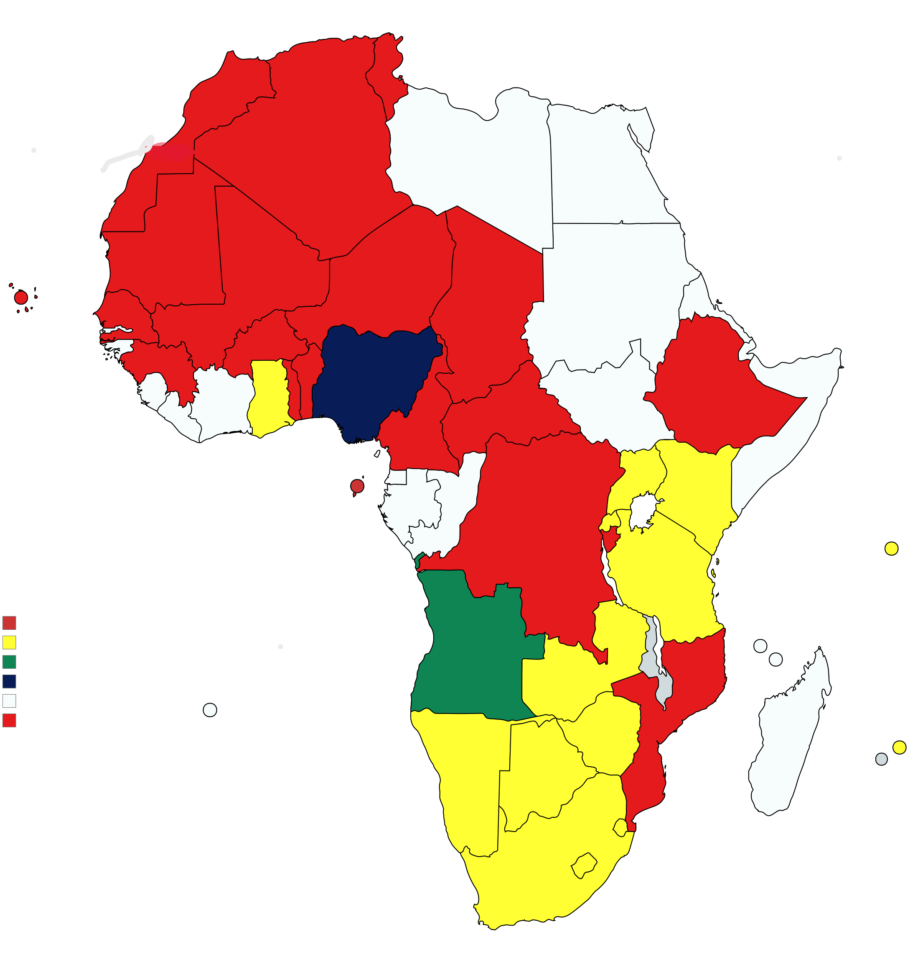
COUNTRIES WITH CREDIT SYSTEM (Number of Credits per Academic Year)
21
60 credits per academic year
14
120 credits per academic year
1
30 credits per academic year
1
80 credits per academic year
37 countries with annual credits varying from 30 to 120 (3 countries without definition/information)
Notes:
No hay definición de Egipto, Chad y Lybia

Slide 14
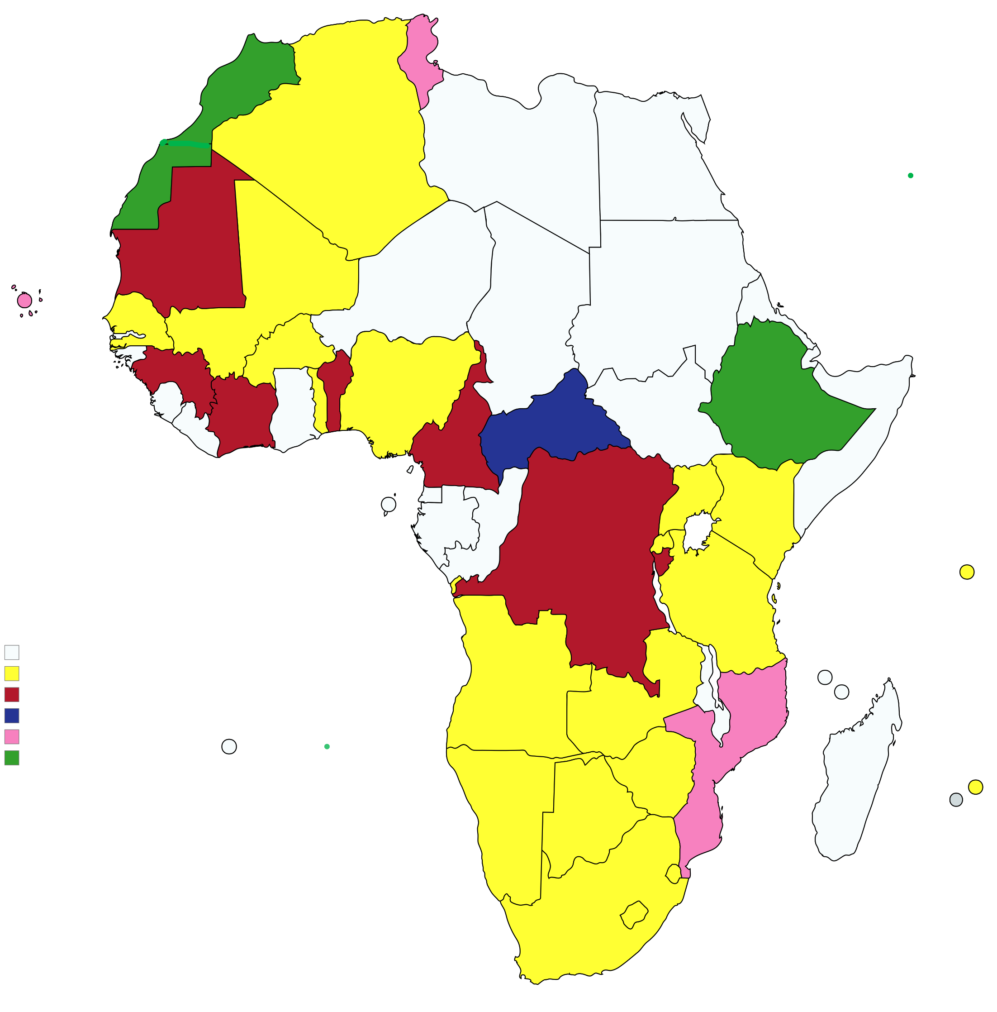
COUNTRIES WITH CREDIT SYSTEM (Number of Hours per Academic year)
21
1200 hours per academic year
7
1500 hours per academic year
2
1620 hours per academic year
1
1800 hours per academic year
3
1500 – 1800 hours per academic year

Slide 15
ACTS in African Regional Integration: ACTS and ACQF
ACTS is embedded in AU Agenda 2063 and the Continental Education Strategy for Africa (CESA 2016–2025). It enables four continental goals:
1
Student mobility across Africa
2
Qualifications recognition across national systems
3
Joint programme development
4
Labour market integration
ACTS and ACQF: Complementary, Not Competing
ACTS
ACQF
Facilitates credit transfer for student mobility
Provides a reference for comparing qualification levels
Operates at the level of courses and study periods
Operates at the level of full qualifications and awards
Supports short-term and partial mobility
Supports recognition of completed qualifications
Requires workload definition and learning outcomes
Requires level descriptors and qualification standards

Slide 16
SECTION 3
Translating Curricula into ACTS:
A Practical Pathway

Slide 17
Step 1 — Establishing the Workload Baseline
1
Estimate total hours a typical student devotes to each course — including ALL components:
Scheduled contact time
Directed study
Lectures, seminars, laboratory sessions, studio time
Assigned readings, problem sets, preparatory exercises
Self-directed study
Assessment preparation & completion
Revision, background reading, exploratory work
Examinations, essays, projects, presentations, portfolios
Worked Example — 16-week semester course
Lectures (2 × 1.5 h/week)
3 h/week
48 h
Seminar/tutorial participation
1 h/week
16 h
Assigned reading & case prep
2.5 h/week
40 h
Group project work
1.5 h/week
24 h
Assessment preparation & completion
—
22 h
TOTAL
—
150 h → 150 ÷ 25 = 6 ACTS credits
Common error: Institutions counting only lecture hours (48 h) assign 2 credits — significantly under-crediting the module and making student burden invisible in official records.

Slide 18
Steps 2 & 3 — Learning Outcomes and Mapping to ACTS Credit Value
2
Articulate Learning Outcomes — A well-formulated learning outcome:
Uses an active verb describing an observable capability (analyse, design, evaluate, apply — not "understand" or "appreciate").
Specifies the subject matter or context to which the capability applies.
Implicitly or explicitly signals the level of complexity (introductory, intermediate, advanced).
3
Map to the ACTS Credit Value — Reference table:
Total workload
ACTS credits
Programme-level credit map provides:
20–25 h
1 credit
A 3-year undergraduate degree → 180 ACTS credits
A 4-year undergraduate degree → 240 ACTS credits
Structural overview of core courses, electives, placements and final projects
Essential information for receiving institutions assessing transfer students
40–50 h
2 credits
60–75 h
3 credits
80–100 h
4 credits
100–125 h
5 credits
120–150 h
6 credits

Slide 19
5 common pitfalls to avoid
Assigning credits without workload estimation
Treating translation as purely administrative
Why it matters: Credits become arbitrary numbers with no meaning for receiving institutions.
Why it matters: Academic staff disengage; credits become bureaucratic labels.
How to avoid it: Always ground credit values in a documented workload estimate, however approximate.
How to avoid it: Involve academic staff in credit allocation, particularly in formulating learning outcomes.
Ignoring existing regional frameworks
Assuming credit equivalence implies content equivalence
Why it matters: ACTS translation inconsistent with EACATS, CAMES or SADCQF creates confusion.
Why it matters: A 3-credit course at one institution ≠ a 3-credit course at another.
How to avoid it: Map ACTS credits to existing regional frameworks; document compatibility explicitly.
How to avoid it: Use learning outcomes to communicate content; use credits to communicate workload.
Attempting institution-wide implementation all at once
How to avoid: Pilot in one or two programmes, document the experience, then build outward.

Slide 20
MODULE 1 | PRE-SESSION INDIVIDUAL ACTIVITY
How Does Your Institution
Compare to ACTS?

Slide 21
The Four Dimensions to Map and Compare
A
Credit definition
B
Workload components
Which components are formally counted?
How does your institution define 1 academic credit?
ACTS: All three components: scheduled teaching + guided independent study + assessment prep & completion
ACTS: 1 credit = 20–25 h total student workload
☐ Contact hours only ☐ Total student workload ☐ Mixed / unclear ☐ Formal written policy exists
☐ Scheduled teaching ☐ Guided independent study ☐ Assessment prep & completion ☐ All three formally counted
Learning Outcomes linkage
Credit transfer & recognition
C
Are learning outcomes formally linked to credit allocation?
D
How does your institution handle incoming credit transfer?
ACTS: Credit allocation formally referenced to module-level learning outcomes
ACTS: Credits recognised based on LO comparability, not course title matching
☐ LOs documented at module level ☐ Credit allocation reviewed vs. LOs ☐ Faculty decide credit values ☐ Registry / central authority decides
☐ Formal written recognition policy ☐ Learning agreements used ☐ LO-based recognition ☐ Ad hoc / case by case only

Slide 22
Key findings
Some systems remain primarily contact-hour based: credits are derived from lecture hours, while independent study and assessment effort are not fully counted in the credit calculation.
Most institutions recognise the three main components of workload: scheduled teaching, guided independent study, and assessment preparation and completion.
However, participants often report that independent study and assessment preparation are not systematically quantified, even if they are acknowledged in policy documents or curriculum guidelines.
Where strong national or institutional frameworks exist, workload is described as “all learning activities engaged in by the student”, but precise hour estimation remains a practical challenge.
Many participants indicate that learning outcomes are documented at module or programme level and that credits are at least nominally linked to these outcomes.
Several systems already use learning-outcomes-based recognition and have formal RPL policies, yet in practice they still rely heavily on content matching and traditional equivalence checks.
Caps on transferable credits, case-by-case decisions and weak inter-institutional agreements are frequently cited as obstacles to full recognition.

Slide 23
MODULE 1 | GROUP ACTIVITY
Workload Calculation Lab:
Translating a Real Module to ACTS

Slide 24
Workload Calculation Lab: Overview and Learning Outcomes
Work in groups of 4–6 to calculate the ACTS credit value of a real module from one of your institutions. Each group selects one module, estimates its total student workload using the ACTS methodology, and reflects on how the result compares with the credits currently assigned.
This activity makes the theoretical content of Section 1 immediately actionable and surfaces the kinds of institutional divergences documented in the HAQAA3 state-of-the-art report.
By the end of this activity you will be able to:
Apply the ACTS workload calculation methodology to a real module.
Identify the three components of student workload and estimate hours for each.
Compare the calculated ACTS credit value with the credits currently assigned at your institution.
Articulate the implications of any divergence for students, for recognition and for programme design.

Slide 25
Activity Timing at a Glance (40 minutes total)
0–5 min
5–30 min
30–40 min
SETUP
MAIN DISCUSSION
CONCLUSION
Each group appoints a moderator to organise the work and to present the results to the plenary
Each group selects a module both members know well.
Groups will work on the Participant Worksheet
Step 1: Identify module & fill in context.
Step 2: List all activities & estimate hours.
Step 3: Calculate total workload → ACTS credits.
Step 4: Compare with current credits & reflect on the questions proposed on the Participant Worksheet.

Slide 26
Group Work: Steps 1 & 2
STEP
1
Choose your module
Select a module at least one member has taught or coordinated. Note: module name, institution, faculty, cycle, semester length, credits currently assigned, and credit system currently used.
Tip: Avoid choosing a module you have never taught — workload estimates require insider knowledge.
STEP
2
List all activities and estimate hours
For each activity, estimate the total hours a student of average preparation would spend. Include EVERYTHING — not just class time.
Component A: Scheduled Teaching
Component B: Guided Independent Study
Component C: Assessment Prep & Completion
Lectures, seminars, labs, tutorials, field sessions
Reading, assignments, group project work, online modules
Exam revision, essays, projects, presentations, portfolios
Common sticking point: Groups often underestimate autonomous study. Ask yourself: "How long does it actually take a student to read one academic article carefully?" (typically 45–90 min)

Slide 27
Group Work: Steps 3 & 4
STEP
3
Calculate your ACTS credit value
Subtotal A — Scheduled teaching
___ h
+ Subtotal B — Guided independent study
___ h
+ Subtotal C — Assessment prep & completion
___ h
= TOTAL student workload (A + B + C)
___ h
÷ ACTS reference value (25 h/credit)
25
= CALCULATED ACTS CREDIT VALUE
___ credits
Credits currently assigned at your institution
___ credits
Difference (calculated − current)
___ credits
STEP
4
Reflect and prepare to share
Q1: What does the difference tell you? (under-credited / over-credited)
Q2: Which component was hardest to estimate reliably, and why?
Q3: What one concrete change would bring this module into ACTS alignment?
Q4: Did this module have formally defined learning outcomes? How did that affect the process?

Slide 28
MODULE 1 | PRESENTATION OF RESULTS OF GROUP DISCUSSION
What have we learned from
the discussion?

Slide 29
MODULE 1 | CONCLUSION
What we learnt in this Module 1?

Slide 30
Key Conceptual Points
ACTS credit reflects student effort, not teaching provision.
1 ACTS credit = 20–25 hours of total student workload.
A full academic year = 60 credits (approx. 1,200–1,500 hours).
Three components of student workload: Scheduled teaching (lectures, labs, seminars) + guided independent study (readings, assignments, projects) + assessment preparation and completion.
Credits track progression, signal workload and facilitate mobility — but they do not guarantee content equivalence or academic quality. A credit is a starting point for dialogue about equivalence, not a guarantee of it.
Credits must be linked to learning outcomes. Without learning outcomes, credit transfer is a bureaucratic formality.
ACTS is voluntary, output-based, and designed to complement — not replace — existing regional frameworks

Slide 31

Thank you very much!

