Slide 2
User’s Guide to the African Standards and Guidelines for Quality Assurance
Jorge Jaime Fringe, CNAQ
11 June 2026

Slide 3
Structure of the ASG-QA
Used by HEIs to:
Ensure their own quality
Carry out self-assessment to improve quality
Part C
QAAs
Part B
AQE
Part A
AQI
ASG-QA
Used by quality assurance agencies to:
Ensure their own quality
Carry out self-assessment in preparation for the external evaluation
Used by quality assurance agencies to carry out institutional evaluations or evaluations of courses and programmes at HEIs

Slide 4
Purpose of the ASG-QA User Manual
To support the implementation of ASG-QA by providing practical guidance and explanations:
Clarifications to improve understanding and interpretation of ASG-QA, particularly regarding aspects of the individual standards that proved challenging in the early years of use;
Guidance on the implementation of the standards for HEIs and QAAs in the early stages of development;
Examples of how HEIs and QAAs can demonstrate that they are fulfilling the ASG-QA commitments by undergoing internal or external evaluations.

Slide 5
Target audience for the ASG-QA user manual
The user manual is intended for:
    Quality assurance professionals in HEIs,
    Quality assurance professionals in quality assurance agencies,
    Experts conducting external evaluations of QA agencies,
    Any organisation.

Slide 6
Scope and application of the ASG-QA user manual
No standards or requirements additional to ASG-QA itself.
Illustrative examples; neither prescriptive nor exhaustive.
Encouragement of its use in support of each country’s national and regulatory standards.
Structured in the same way as the ASG-QA
It should be read in conjunction with the ASG-QA.

Slide 7
Contents of the ASG-QA User Manual
Further explanation of key concepts and terminology in quality assurance
Examples of key points and/or guiding questions
Examples of good practice for each standard
Examples of how compliance with each standard can be demonstrated through a self-assessment and/or external assessment

Slide 8
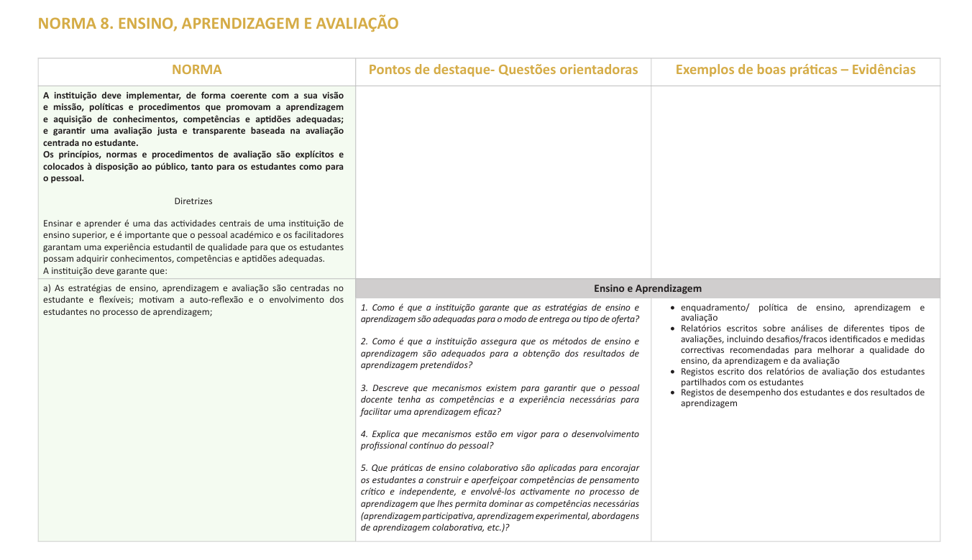
Contents of the ASG-QA User Manual

Slide 9
Part A, Standard 2. Governance and management
The institution must clearly state its governance and management structures. This will ensure sound and ethical governance and management, including robust GQ practices that support the fulfilment of its mission and statutory mandate.
  Qualifications, competence and experience of leadership
  Appropriateness of governance bodies
  GQ policy and structure
  Participation in decision-making processes
  Ethics, transparency and integrity in activities

Slide 10
Part A, Standard 2. Governance and management
Key points/guiding questions What are your governance and management structures like? To what extent are students involved in these bodies? Do the relevant bodies have clearly defined mandates, roles and responsibilities? If your institution has a quality assurance policy, what is the procedure for its implementation? | Examples of good practice/evidence Organisational chart of the institution Institution’s statutes Selection process for senior management positions Relevant quality policy

Slide 11
Part B, Standard 3: Quality Assurance Implementation Processes
Standards, processes and procedures for AEQ must be predefined, credible, published and consistently implemented to ensure accountability
Quality assessment conducted in a professional, consistent and transparent manner.
External evaluation conducted on the basis of the self-evaluation prepared by the institution.
  Visit to the institution’s premises
  Interviews with partners
  Oral, preliminary and final reports
  Monitoring activities to ensure the implementation of the external evaluation’s recommendations

Slide 12
Part B, Standard 3: GQE implementation processes
Key points/guiding questions What measures has the agency adopted to ensure that the instruments and processes are credible? What are the steps/phases in the external evaluation process? How are HEIs informed about the objectives and purposes of the external evaluation processes? Have clear guidelines for report preparation been defined and communicated to the institution and the expert evaluator? | Examples of good practice/evidence Manuals/Documents for external evaluation procedures AGQ documents (website, brochures, written or oral communications, etc.) Documents describing the main stages of external evaluation and follow-up on recommendations Documents for monitoring implementation procedures

Slide 13
Part C, Standard 7. Human and financial resources
The AGQ must have adequate and appropriate human and financial resources, as well as material resources, to fulfil its quality assessment mandate effectively and efficiently
The QA Agency has adequate funds to pursue its vision and mission.
  It has facilities suitable for its quality assurance activities;
  Sufficient and qualified human resources to carry out its quality assurance functions.
  Ensure improvements in its practices and development; and
  Inform the public about its activities and results

Slide 14
Part C, Standard 7. Human and financial resources
Key points/guiding questions Describe and analyse the human, financial and material resources available to your AAQ to effectively carry out its functions. Demonstrate how the Agency’s financial and human structure ensures the sustainability of its activities within the scope of and in harmony with the ASG – QA. | Examples of good practice/evidence Annual budgets and unaudited financial statements of the QAAs Strategic plan Activity report Table illustrating staff statistics by educational qualifications, gender and age.

Slide 15
Task
Taking into account all the ASG-QA standards, name three that you consider challenging in terms of their implementation or evidence/best practice. Why?

