Slide 1




THE INTERPLAY BETWEEN INTERNAL QUALITY ASSURANCE (IQA) and EXTERNAL QUALITY ASSURANCE (EQA)
Mpendulo Nyamane
Acting Chief Executive Officer
Eswatini Higher Education Council (ESHEC)
The Eswatini Experience
www.eshec.org.sz

Slide 2

Presentation Layout
ESHEC’S role in Quality Assurance
Interplay between IQA and EQA
ESHEC-HEI Quality Assurance Cycle
Common Challenges
Good Practices
Strengthening Collaboration Between IQA And EQA
Conclusion

Slide 3
IMPORTANCE OF TVET
ESHEC'S ROLE IN QUALITY ASSURANCE
The Eswatini Higher Education Council (ESHEC) was established through the Higher Education Act, 2013 as the national quality assurance and regulatory body for higher education.
ESHEC is mandated to:
• Register Higher Education Institutions
• Accredit academic programmes
• Monitor institutional compliance
• Promote quality assurance and enhancement
• Advise Government on higher education matters
• Support continuous improvement across the sector
Our role extends beyond regulation. We view quality assurance as a shared responsibility between institutions and the regulator, aimed at ensuring quality, relevance, accountability, and public confidence in higher education.

Slide 4
INTERPLAY BETWEEN IQA and EQA
From ESHEC's perspective
Internal Quality Assurance and External Quality Assurance are complementary rather than separate processes.
IQA is owned by institutions and provides the foundation for quality enhancement through policies, systems, evidence, and continuous self-evaluation.
EQA provides independent verification, accountability and external validation of those internal systems.
A robust EQA process actually relies heavily on the maturity of an institution's IQA.

Slide 5
ESHEC-HEI Quality Assurance Cycle
Institutional IQA Systems
Self Assessment Report
Programme accreditation review
Site Visit
Institutional self-assessment
Programme accreditation processes
Submission of evidence and performance data
Site visits and stakeholder engagements
Improvement plans
Follow-up monitoring activities
Accreditation decision
The Improvement Plan is where IQA and EQA interact most effectively
Improvement Plan
Monitoring & Plan
Re-accreditation
www.eshec.org.sz

Slide 6
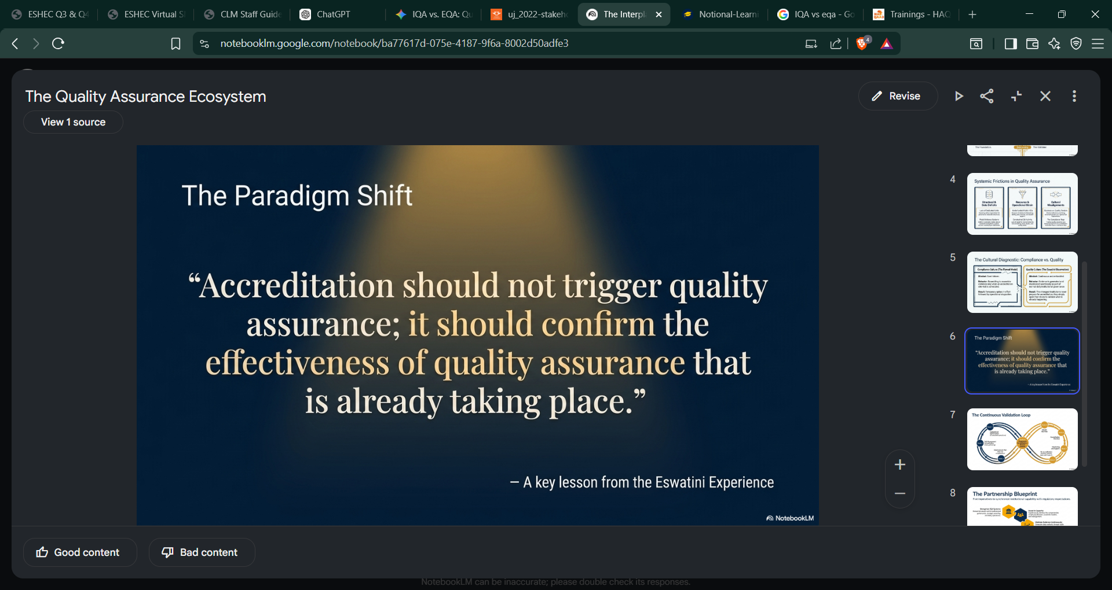
www.eshec.org.sz

Slide 7
COMMON CHALLENGES
LACK OF DEDICATED IQA STRUCTURES
Some institutions still operate without dedicated Quality Assurance Units or specialised QA personnel.
LIMITED RESOURCES
Quality assurance activities such as benchmarking, staff development, tracer studies, quality audits, and participation in QA networks require resources that are often constrained.
BALANCING BUSINESS AND QUALITY
Particularly within private institutions, there can be tension between enrolment growth objectives and quality assurance requirements.
UNDERFUNDING OF PUBLIC INSTITUTIONS
Resource limitations may affect staffing, infrastructure, research, laboratories, libraries, and student support services.
WEAK DATA AND EVIDENCE SYSTEMS
Many institutions struggle to generate reliable data on graduate employability, student success, employer satisfaction, and institutional performance.
COMPLIANCE CULTURE RATHER THAN QUALITY CULTURE
Some institutions view quality assurance primarily as preparation for accreditation visits rather than a continuous institutional responsibility.

Slide 8

GOOD PRACTICES
Institutions that perform well typically demonstrate:
• Strong leadership commitment to quality
• Functional and adequately resourced IQA structures
• Evidence-based decision-making
• Continuous monitoring and improvement
• Active stakeholder engagement
• Open and constructive engagement with the regulator.
One observation from the Eswatini experience is that the strongest institutions do not prepare for accreditation. They maintain quality continuously, and accreditation simply validates what is already happening.

Slide 9
STRENGTHENING COLLABORATION BETWEEN IQA AND EQA
To strengthen the relationship between institutions and quality assurance agencies, five practical recommendations:
1. Strengthen Institutional IQA Systems
Quality assurance should be embedded within institutional governance, planning, and daily operations.
2. Invest in Quality Assurance Capacity
Institutions should continuously develop the competencies of QA practitioners, academic leaders, and management.
3. Maintain Evidence Continuously
Evidence should be generated and maintained as part of normal institutional processes rather than assembled only during accreditation exercises.
4. Promote Continuous Dialogue
Regular engagement between institutions and regulators helps build trust, improve understanding, and resolve challenges early.
5. Adopt a Partnership Approach
Quality assurance works best when regulators and institutions view themselves as partners pursuing a common objective rather than as opposing parties.
www.eshec.org.sz

Slide 10
CONCLUSION
The relationship between IQA and EQA is fundamental to effective higher education quality assurance.
Strong IQA systems enable institutions to continuously improve, while EQA provides accountability, validation, and public confidence.
The Eswatini experience demonstrates that quality assurance is most effective when institutions and regulators work collaboratively, communicate openly, and remain committed to continuous improvement.
Ultimately, the goal of both IQA and EQA is not accreditation itself, but the delivery of quality education that transforms lives, supports national development, and prepares graduates for the future.
www.eshec.org.sz

Slide 11

THANK YOU
www.eshec.org.sz

