Slide 1



9 e 10 fevereiro 2026
HAQAA3 Training Briefing: Internal Quality Assurance (IQA)
The ARES and Quality Assurance (QA) in Higher Education in Cabo Verde
Understanding the Interaction between Internal Quality Assurance (IQA) and External Quality Assurance (EQA)
João Dias, Ph.D. | Chairman of the Board of Directors of ARES
June 17, 2026

Slide 2
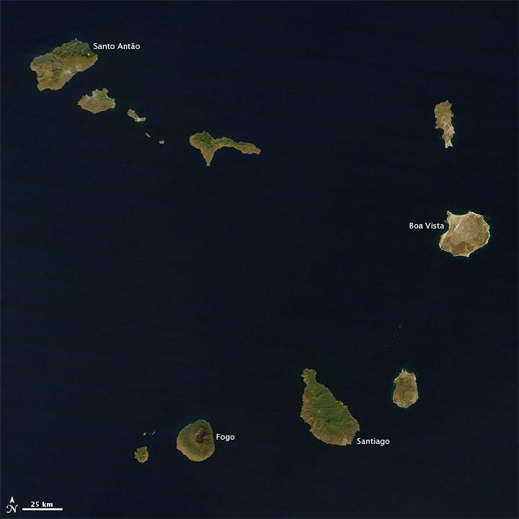
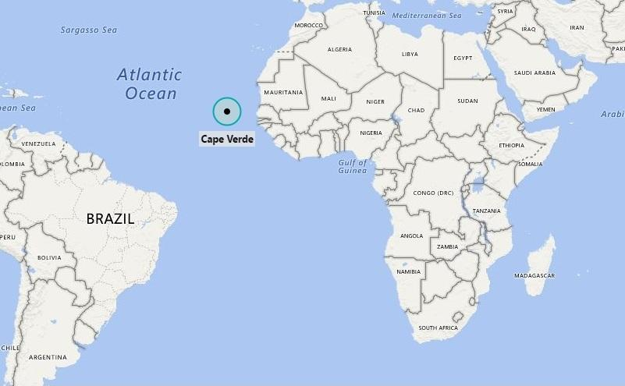
Cape Verde: National Context
Small Island Developing State
10 islands and 9 inhabited
Approximately 500,000 inhabitants
Limited natural resources
Strong investment in human capital

Slide 3
Cape Verde: National Context
Small Island Developing State
10 islands and 9 inhabited
Approximately 500,000 inhabitants
Limited natural resources
Strong investment in human capital
“In Cape Verde, the main strategic resource is knowledge.”

Slide 4
Introduction
Higher Education in Cabo Verde: A Growing System
Cabo Verde is a small island developing state with a dynamic higher education sector.
The system comprises both public and private higher education institutions.
Over the past decades, the sector has experienced significant expansion.
Ensuring quality, relevance, and public trust has become increasingly important.
Internationalization is creating new opportunities and challenges.
“Quality is not an end in itself; it is a means to build trust, foster continuous improvement, and contribute to national Development.”

Slide 5
Who is ARES?
ARES is the independent public authority responsible for regulating and assuring the quality of higher education in Cabo Verde.
Main Responsibilities
Institutional and programme evaluation;
Accreditation of study programmes and institutions;
Inspection and monitoring activities;
Promotion of a quality culture;
Support for institutional quality assurance systems;
Production of evidence to inform decision-making.

Slide 6
Who is ARES?
ARES is the independent public authority responsible for regulating and assuring the quality of higher education in Cabo Verde.
Guiding Principles
Independence;
Transparency;
Accountability;
Continuous improvement;
Institutional cooperation.

Slide 7
The Cabo Verde QA Model
Quality as a Shared Responsibility
HEI - Responsible for:
Designing and delivering academic programmes;
Implementing internal quality assurance systems;
Conducting self-evaluations;
Ensuring continuous improvement.

Slide 8
The Cabo Verde QA Model
Quality as a Shared Responsibility
ARES - Responsible for:
External evaluation;
Accreditation;
Monitoring and oversight;
Promotion of quality standards.

Slide 9
The Cabo Verde QA Model
Quality as a Shared Responsibility
HEI - Responsible for:
Designing and delivering academic programmes;
Implementing internal quality assurance systems;
Conducting self-evaluations;
Ensuring continuous improvement.
ARES - Responsible for:
External evaluation;
Accreditation;
Monitoring and oversight;
Promotion of quality standards.

Slide 10
The Cabo Verde QA Model
Quality as a Shared Responsibility
Core Principle:
Quality is created within institutions;
ARES validates, supports, and enhances those efforts through external quality assurance.

Slide 11
Internal Quality Assurance (IQA)
What Do We Mean by IQA?
Internal Quality Assurance refers to the policies, procedures, and mechanisms implemented by institutions to monitor, assess, and improve their own performance.

Slide 12
Internal Quality Assurance (IQA)
What Do We Mean by IQA?
Internal Quality Assurance refers to the policies, procedures, and mechanisms implemented by institutions to monitor, assess, and improve their own performance.

Slide 13
Internal Quality Assurance (IQA)
Key Components
Institutional quality policy;
Quality management structures;
Data and information systems;
Student feedback mechanisms;
Teaching and learning evaluation;
Graduate employability monitoring;
Periodic programme review.

Slide 14
Internal Quality Assurance (IQA)
Key Components
Institutional quality policy;
Quality management structures;
Data and information systems;
Student feedback mechanisms;
Teaching and learning evaluation;
Graduate employability monitoring;
Periodic programme review.
Fundamental Question
"How do we know that we are fulfilling our mission effectively?"

Slide 15
External Quality Assurance (EQA)
The Role of ARES
External Quality Assurance assesses whether institutional quality systems are effective and whether they meet nationally established standards.

Slide 16
External Quality Assurance (EQA)
The Role of ARES
External Quality Assurance assesses whether institutional quality systems are effective and whether they meet nationally established standards.
Main Instruments
Institutional evaluations;
Programme evaluations;
Accreditation procedures;
Quality audits;
Inspection activities.
Main Objectives
Protect students and society;
Strengthen public confidence;
Encourage continuous improvement;
Ensure compliance with quality standards.

Slide 17
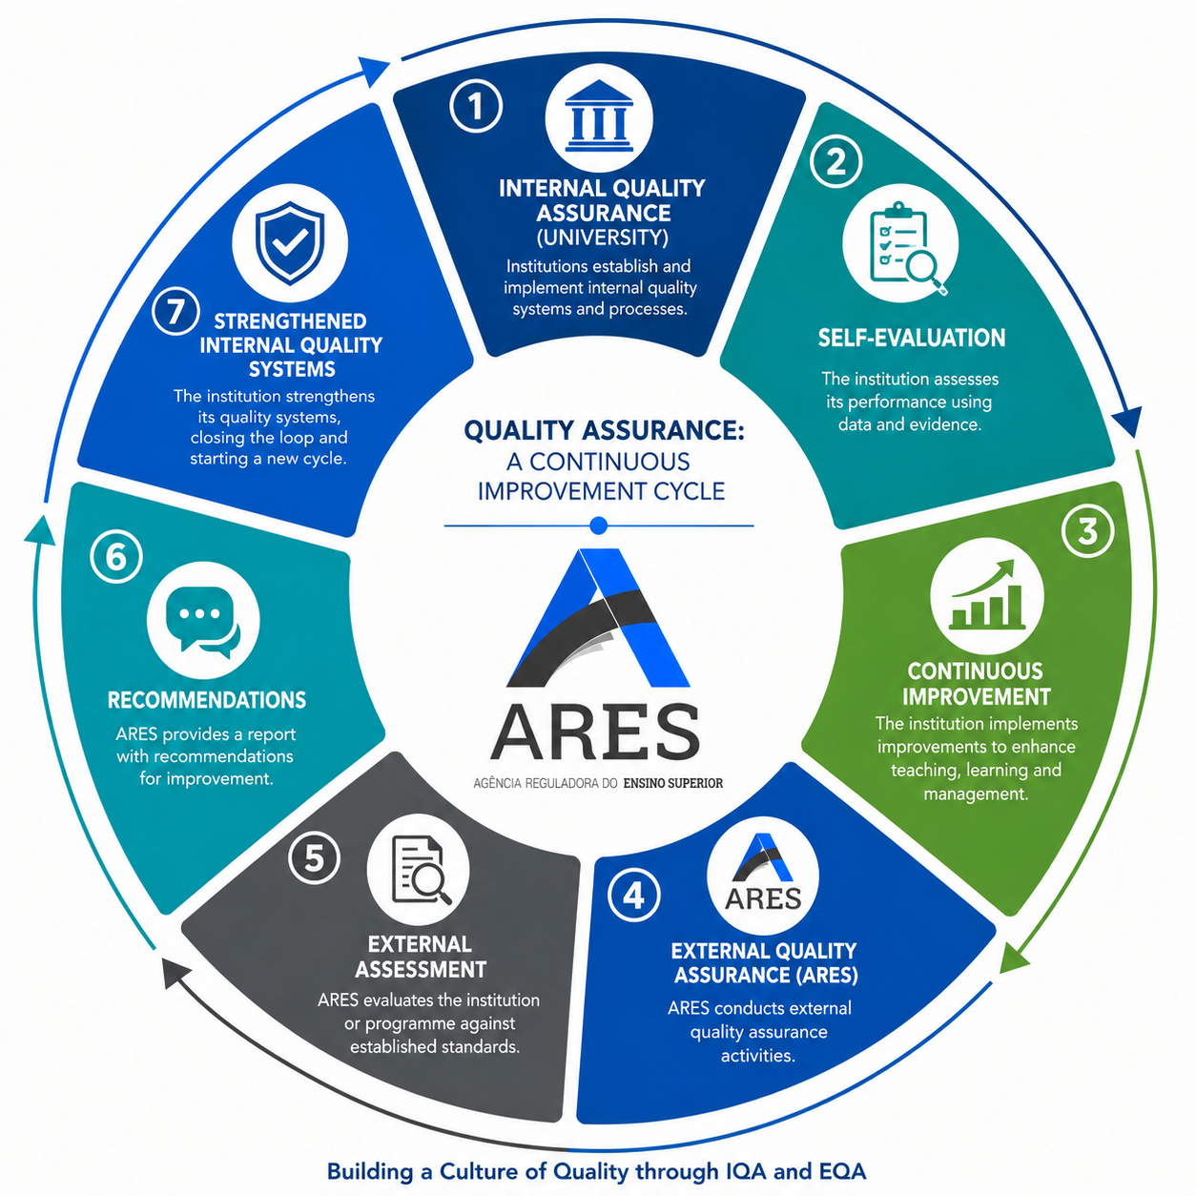
The Relationship Between IQA and EQA
A Complementary Partnership

Slide 18
The Relationship Between IQA and EQA
Key Message
EQA does not replace IQA.
The effectiveness of external quality assurance depends on strong institutional ownership of quality and robust internal systems.

Slide 19
How ARES Works with HEI
A Collaborative Approach
Before Evaluation
Capacity-building activities;
Training workshops;
Dissemination of standards and guidelines;
Technical guidance and support.
During Evaluation
Dialogue with institutional leadership;
Meetings with academic staff;
Engagement with students and stakeholders;
Site visits and evidence review.

Slide 20
How ARES Works with HEI
A Collaborative Approach
Before Evaluation
Capacity-building activities;
Training workshops;
Dissemination of standards and guidelines;
Technical guidance and support.
During Evaluation
Dialogue with institutional leadership;
Meetings with academic staff;
Engagement with students and stakeholders;
Site visits and evidence review.

Slide 21
How ARES Works with HEI
A Collaborative Approach
Before Evaluation
Capacity-building activities;
Training workshops;
Dissemination of standards and guidelines;
Technical guidance and support.
During Evaluation
Dialogue with institutional leadership;
Meetings with academic staff;
Engagement with students and stakeholders;
Site visits and evidence review.
After Evaluation
Feedback reports;
Recommendations for improvement;
Follow-up and monitoring activities.

Slide 22
Benefits of Cooperation Between ARES and HEI
For Institutions
Stronger governance and management;
Improved academic quality;
Enhanced credibility and reputation;
Greater international recognition.
For Students
Better learning experiences;
Increased confidence in qualifications;
Improved employability prospects.
For Society
Highly qualified graduates;
Stronger national development;
Greater public trust in higher education.

Slide 23
Benefits of Cooperation Between ARES and HEI
For Institutions
Stronger governance and management;
Improved academic quality;
Enhanced credibility and reputation;
Greater international recognition.
For Students
Better learning experiences;
Increased confidence in qualifications;
Improved employability prospects.
For Society
Highly qualified graduates;
Stronger national development;
Greater public trust in higher education.

Slide 24
Benefits of Cooperation Between ARES and HEI
For Institutions
Stronger governance and management;
Improved academic quality;
Enhanced credibility and reputation;
Greater international recognition.
For Students
Better learning experiences;
Increased confidence in qualifications;
Improved employability prospects.
For Society
Highly qualified graduates;
Stronger national development;
Greater public trust in higher education.

Slide 25
Current Challenges
Key Challenges in Cabo Verde
Limited specialized human resources;
Strengthening quality culture across institutions;
Developing integrated information systems;
Responding to internationalization trends;
Aligning with African and international quality frameworks.
ARES Response
Continuous professional development;
International cooperation and partnerships;
Participation in continental and global quality assurance networks;
Promotion of evidence-based quality enhancement.

Slide 26
Current Challenges
Key Challenges in Cabo Verde
Limited specialized human resources;
Strengthening quality culture across institutions;
Developing integrated information systems;
Responding to internationalization trends;
Aligning with African and international quality frameworks.
ARES Response
Continuous professional development;
International cooperation and partnerships;
Participation in continental and global quality assurance networks;
Promotion of evidence-based quality enhancement.

Slide 27
International Engagement
ARES actively participates in regional and international quality assurance initiatives.
Examples:
ENQA
PAQAA
HAQAA
AAU
Strategic Goal
To strengthen the credibility, comparability, and international recognition of Cabo Verde's higher education system.

Slide 28
International Engagement
ARES actively participates in regional and international quality assurance initiatives.
Examples:
ENQA
AfriQAN
PAQAA
HAQAA
AAU
Strategic Goal
To strengthen the credibility, comparability, and international recognition of Cabo Verde's higher education system.

Slide 29
International Engagement
ARES actively participates in regional and international quality assurance initiatives.
Examples:
ENQA
AfriQAN
PAQAA
HAQAA
AAU
Strategic Goal
To strengthen the credibility, comparability, and international recognition of Cabo Verde's higher education system.

Slide 30
Key Takeaways
Quality is a shared responsibility.
Internal Quality Assurance is the foundation of sustainable quality.
External Quality Assurance promotes accountability and trust.
Effective collaboration between HEI and quality assurance agencies is essential.
The ultimate goal is student success and societal development.

Slide 31
Conclusions
From Compliance to a Culture of Quality
"Quality assurance systems are most effective when they move beyond compliance and become instruments for institutional learning, innovation, and continuous improvement."

Slide 32
Conclusions
From Compliance to a Culture of Quality
"Quality assurance systems are most effective when they move beyond compliance and become instruments for institutional learning, innovation, and continuous improvement.“
Thank you

Slide 33
"At ARES, we see quality assurance not as a control mechanism, but as a partnership for improvement. The success of external quality assurance depends on the strength of internal quality systems, mutual trust, transparency, and a shared commitment to providing students with the best possible educational experience. By working together, HEI and quality assurance agencies can create a culture of quality that supports excellence, innovation, and sustainable development."

