Slide 1
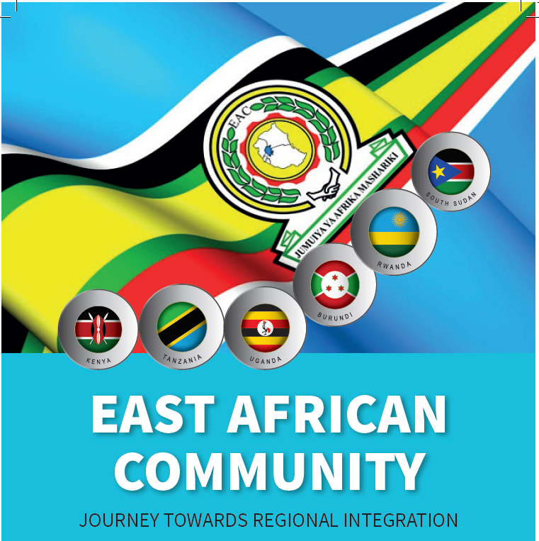
REGIONAL QUALITY ASSURANCE FRAMEWORKS & TOOLS IN EAST AFRICA
Presentation of IUCEA at the HAQAA3 IQA Training Workshop
11th June 2026
Prof. Michael Mawa
Chief Principal
Quality Assurance and Qualifications Framework
mmawa@iucea.org

Slide 2


Presentation Outline
Background to the QA System in East Africa
Legal Framework for Establishing a Regional QA System
Institutional Framework for QA in EAC (QA Agencies)
EAC as a Common Higher Education Area
Regional QA Policies, Tools, Frameworks
Some Challenges and Strategies in establishing harmonised regional QA system

Slide 3
Background to the Regional QA System in East Africa
The establishment of a regional quality assurance system in East Africa has been a gradual process.
The hallmark of this process has been the enactment of legal instruments, adoption of relevant policies, establishment of QA institutions/agencies, capacity building and QA Networking.
In 2006, IUCEA in collaboration with National Councils and Commissions for higher education and its partner DAAD agreed to jointly undertake a regional QA initiative in HEs in East Africa.
Initially, the initiative involved a consensus building process through engaging key stakeholders in consultative dialogue events.
QA Capacity Building was critical in establishing this QA system

Slide 4

The Legal Framework on QA and Harmonization of Higher Education in East Africa
Key Legal Instruments for Harmonisation of HE Quality Assurance & Qualifications in EAC:
The East African Community Treaty - Art. 102 (Partner States agreed to harmonise education and promote mobility and recognition of qualifications).
The Common Market Protocol - Art. 11 (Free movement of people, labour and services; requiring mutual recognition of qualifications and cross-border education)
The IUCEA Act, 2009 - Art. 4 & Art. 6.
Harmonization of higher education entails the establishment of regional systems that would facilitate comparability of higher education systems in the East African Community Partner States.

Slide 5
IUCEA as a Regional QAA
IUCEA is an agency of the EAC
The broad mandate of IUCEA (Act of 2009) is to, among other things:
  Advise Partner States of the EAC on matters of higher education
  Coordinate higher education and research in EAC
  Promote Quality of education by establishing quality assurance system in the EAC
    Development of QA Policies and Standards
    Capacity Building (Training of QA Officers)
    Dissemination of QA information
    Facilitating QA Dialogue among key higher education actors
  Facilitate networking among HEIs and QA Agencies in the region

Slide 6
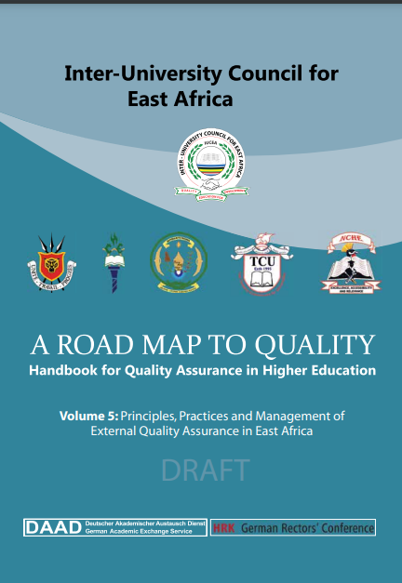
Institutioonal Framework:
The QAA in EAC
The EAC Partner States have established QAA
Seven of these QAA are now functional:
  Permanent Commission for Higher and University Education - DRC
  National Commission for Higher Education (NCHE) – Burundi
  Commission for University Education (CUE) – Kenya - 1985
  Higher Education Council (HEC) – Rwanda
  Tanzania Commission for Universities (TCU) – Tanzania - 1995
  National Council for Higher Education (NCHE) – Uganda – 2001
  National Council for Higher Education (NCHE) – South Sudan, established by the Higher Education Act of 2012.
  National Commission for Higher Education, Somalia - 2025
Over the years, IUCEA and its national and international partners have progressively built a regional QA System and indeed a Common Higher Education Area anchored on QA policy frameworks, Qualifications Framework, common programeme standards and QA Networking

Slide 7
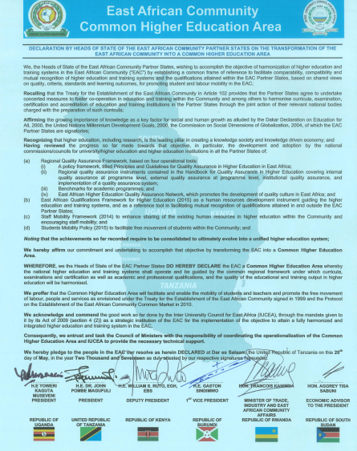
East African Community - a Common Higher Education Area (EACHEA)
A Declaration was made by the 18th Summit of the EAC Heads of State on May 20, 2017 in Dar Es-Salaam, Tanzania
The objective was to transform East Africa into a Common Higher Education space characterized by comparable, compatible, coherent and harmonized systems of Higher Education thereby facilitating free mobility of student, staff, programmes, and institutions, and mutual recognition of qualifications.

Slide 8
Building Blocks for the EACHEA
Regional Quality Assurance System, incorporating:
  QA policy framework
  Standards, guidelines and procedures
  Programme benchmarks
East African Qualifications Framework for Higher Education, EAQFHE
  Platform for anchoring national qualifications frameworks for their harmonization
  Provides for many policies and guidelines (including QIP, CAT, RPL)
3. Regional Accreditation System (Quality-Based) for Academic Programmes
4. Students and Staff Mobility Programme – facilitating HE mobility in the region.
5. East African Quality Assurance Network for Higher Education, EAQAN – An expanding community of QA practitioners

Slide 9
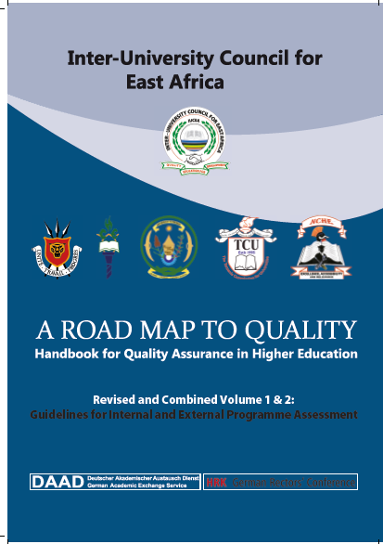
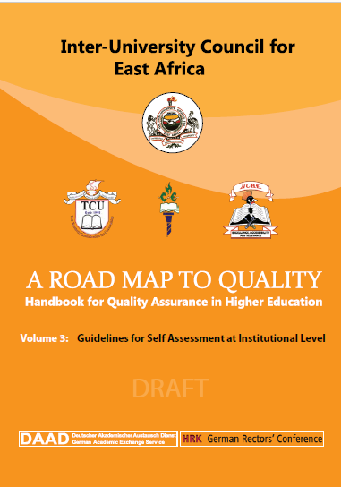
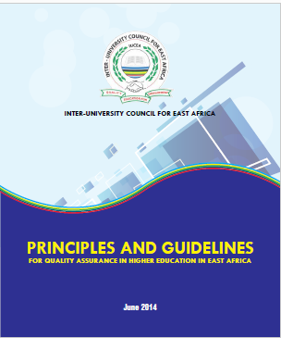
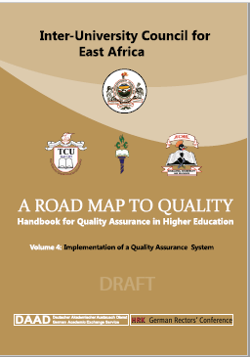
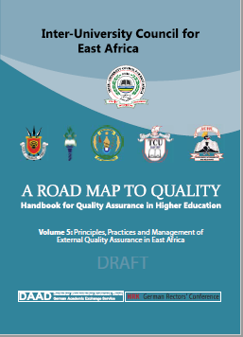
1. Quality Assurance Policy Frameworks and Tools
b) Handbook for Quality Assurance in Higher Education “Roadmap to Quality”, in 5 Volumes
a) Principles and Guidelines for Quality Assurance in Higher Education in East Africa
A common frame of reference guiding higher education institutions and national commissions and councils for higher or university education in developing and practicing a common quality assurance culture,

Slide 10
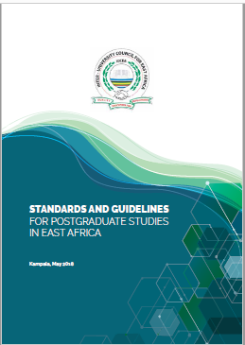
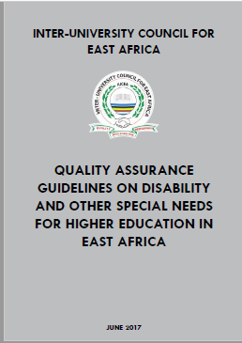
Other Relevant QA Policy Instruments

Slide 11
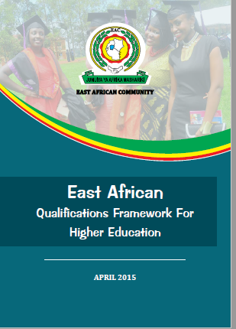
2. East African Qualifications Framework for Higher Education
Adopted in 2015 as an overarching framework for harmonisation of higher education and training systems in the EAC region
Provides the framework for mutual recognition of qualifications among the EAC Partner States, thereby enabling free movement of students and labour in the Partner States
Provides international comparability of qualifications in EAC
Promotes workers and learners’ mobility in the Community – CATS and Mutual Recognition of Qualifications
Facilitates lifelong learning through Recognition of Prior Learning (RPL)

Slide 12
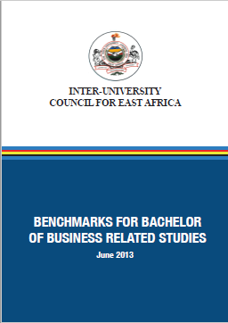


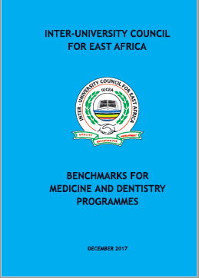

Quality Assurance in EAQFHE and Programme Benckmarking
EAQFHE – Qualifications Programme Benckmarking Policy (Annex V)
A useful policy tool for programme development and review
Require benchmarks to set out the expected attributes and competencies of graduates (knowledge, skills, attitudes)
Require benchmarks to defines the nature and extent of the programme content, teaching, learning and assessment
Policy requires benchmarks to define expected learning outcomes; thus, it is outcome-based, learner-centred and allow for flexibility and innovation in programmes

Slide 13
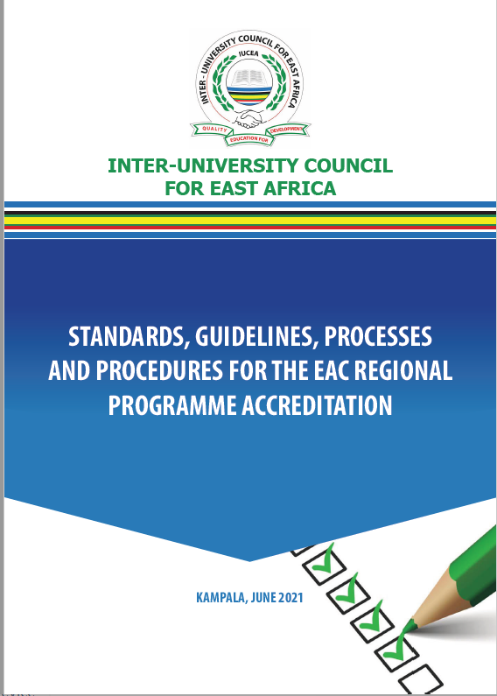
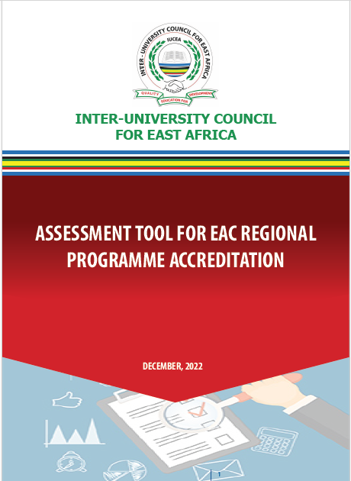
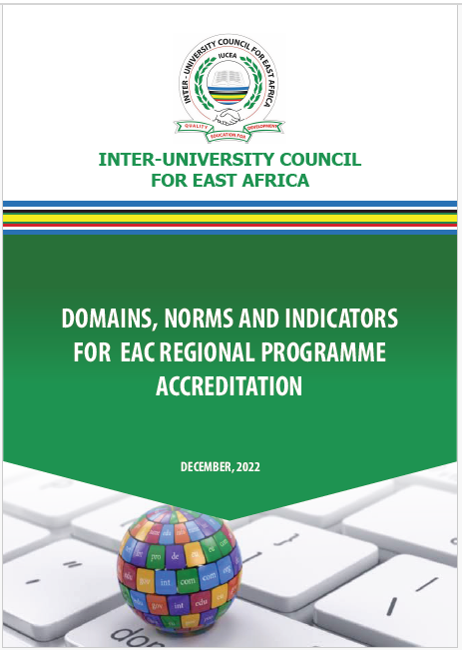
3. Quality Assurance in Programme Accreditation in East Africa
EAC has, since 2022, adopted a Regional Programme Accreditation Framework.
The Framework is defined by Standards, Guidelines, procedures, and assessment tools.
This accreditation process is Voluntary, Quality-based mechanism, anchored on National Accreditation process.

Slide 14

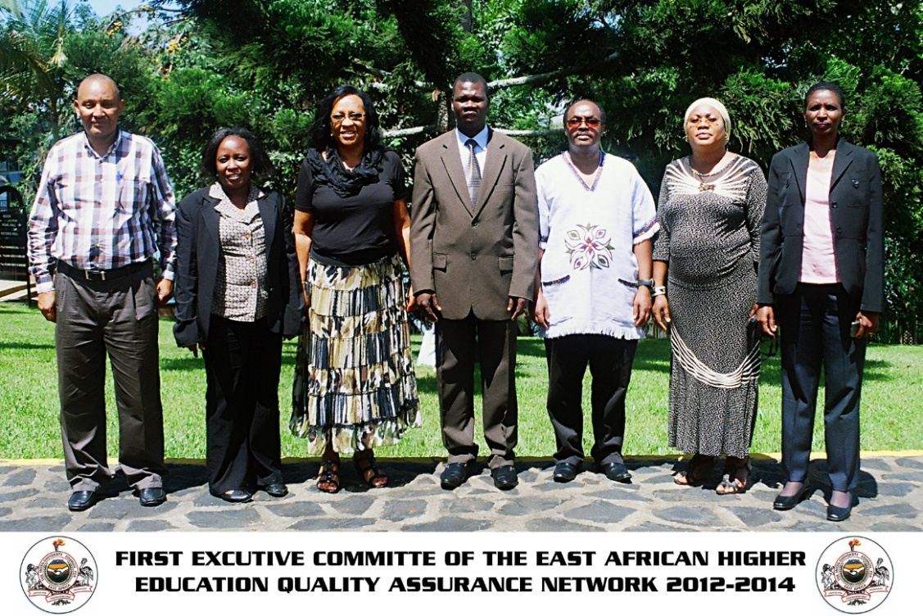
4. Quality Assurance Networking
The East African Higher Education Quality Assurance Network (EAQAN) was established in 2012 by QA practitioners as a regional vehicle to:
  Sustain continues capacity building and information sharing
  Promote quality of higher education
  Champion and entrench QA culture in HE in EAC
  Sustain the regional QA system

Slide 15
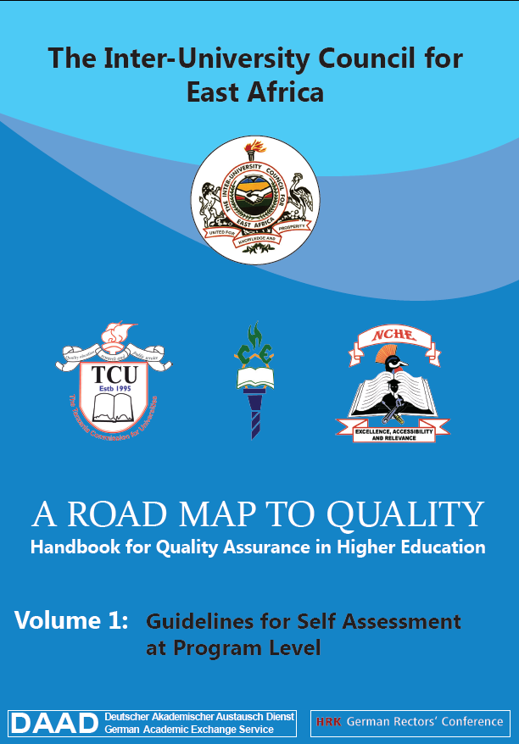
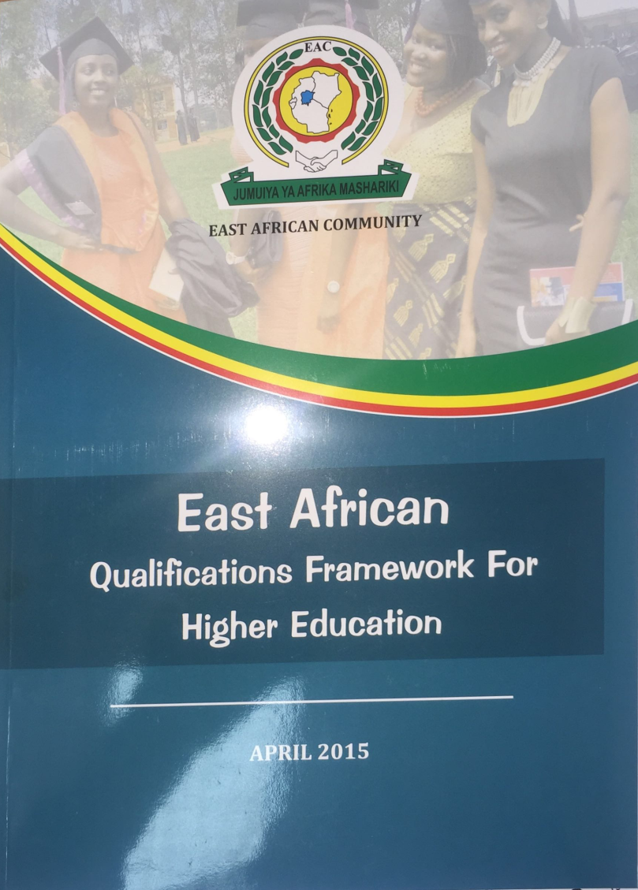
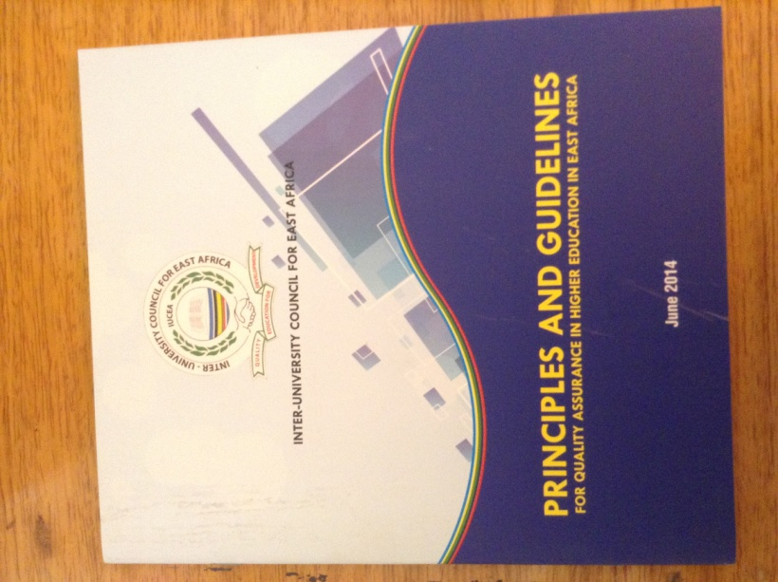
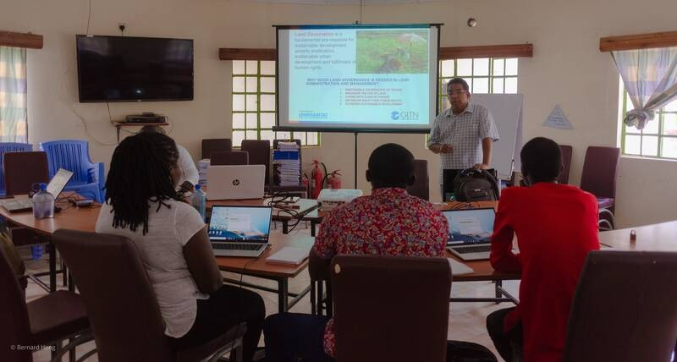
Some Challenges/Strategis in Establishing the EAC Regional QA System
Resistance from some higher education actors
Slow implementation of regional quality assurance frameworks by some HEIs and QA Agencies
Limited funds for increased capacity building of QA Officers
However, some strategies have been adopted including:
  Continuous Engagement of key actors in QA dialogue sessions
  Capacity building and Benchmarking support
  Cost-sharing measures for engagement in activities

Slide 16

Thank You

