Slide 1
IQA and EQA: Interaction between the Two Dimension
HAQAA3 Internal Quality Assurance Training
Presentation by Dr Sylvia Demas
17 June 2026

Slide 2
1. About NCHE
Advise on Allocation of State Funds to Public HEIs
Promote Quality Assurance in HEIs
Accredits HE programmes in concurrence with the Namibia Qualifications Authority (NQA)
Conducts institutional quality audits
Estimates subsidies for public HEIs
Mandates
&
Functions
Promote Coordinated HE System
Promote Student Access to HEIs
Monitors trends in HE (enrolment, outcomes, and staff capacity)
Evaluates the impact of HE (graduate surveys and other research activities)
Recommends the levels of tuition fees charged in HEIs
Administers the regulations and recommends applications for registration as private HEIs
Vision: To be a valued leader and a partner in coordinating quality HE in pursuit of a knowledge-based society.

Slide 3
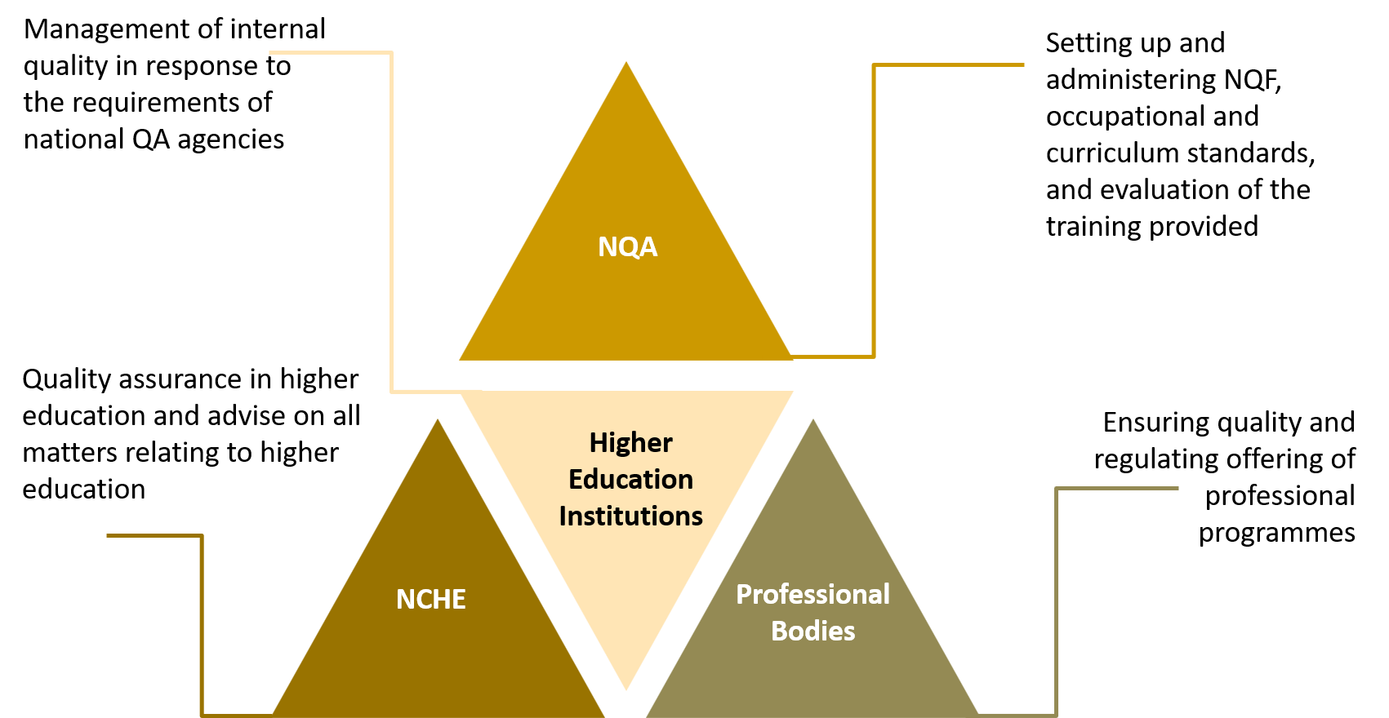
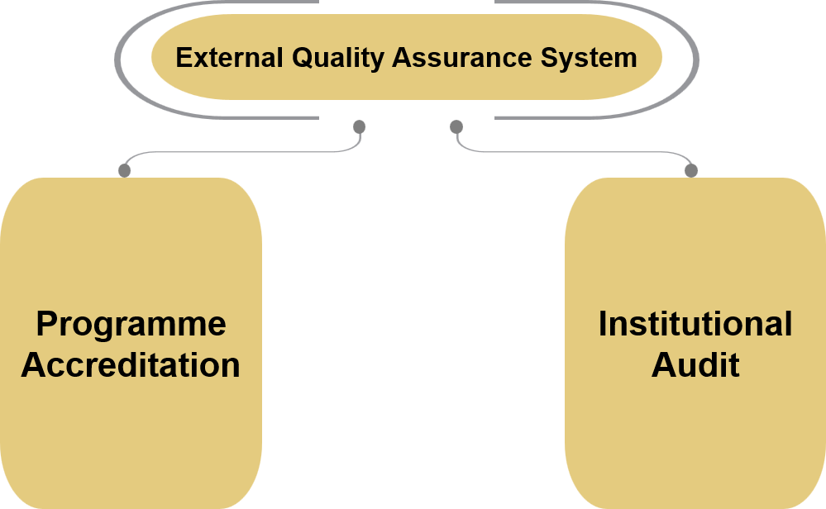
2. Namibia’s Higher Education Quality Assurance System and the Interplay between EQA and IQA
QA System
EQA Subsystems

Slide 4
3. Good Practices and Challenges between HEIs and NQAAA
Good Practice
The external HE QA System, NQF and the Regulations and Procedures for various professional programmes are publicly available and accessible, providing transparent evaluation mechanisms.
It is on these systems and frameworks that the HE QA systems are built and maintained.
Each HEI has a QA policy, functions and a support structure, albeit at different levels.
IQA officials are the NQAA’s first port of call, serving as bridge between the agency and institutions.
Currently, collaboration is mainly during the external review exercises, but there is room for improvement.
Challenges
Lack of ownership of QA system within HEIs – situation more skewed towards compliance.
  Sometimes no evidence of internal approval of proposed programmes or institutional reports.
  Unavailability of senior managers to respond to cross-cutting administrative issues such as finance, HR and facility management during site visits.
  Poor follow-up on external review recommendations/ conditions and production of programme improvement plan.
Lack of human capacity and knowledge of QA, compounded by staff turnover for both NQAA and HEIs.

Slide 5
  4. Recommendations for Strengthening Collaboration
NQAA can introduce a programme for incentivising good practice among HEIs to promote quality culture and positive competition.
EQA and IQA Practitioners, Statisticians, and Institutional Planners in NQAA and HEIs should regularly work together in aggregating and collating external review findings with administrative reports to provide an institutional overview for holistic improvement solutions and design of targeted capacity development programmes.
Programme Accreditation Recommendations | Institutional Audit Recommendations | Annual Statistics | Student Surveys | Graduate Surveys
Aims and Objectives Curriculum Assessment Staff Facilities and Support Internal Quality Management System Finance/ Outcomes | Institutional vision, mission and goals; and general management processes Teaching and learning Research Community engagement | Throughput and repetition rates Staff qualification | Factors contributing to student success/ failure Student satisfaction survey Course/ module and staff assessment reports | Usefulness and relevance of qualification to the job Graduate employment rate

Slide 6
Example of Aggregating Accreditation Findings: Summary of Programme Accreditation Results
Student-course evaluation, annual statistics and graduate survey
Annual student progression rates and graduate feedback on the relevance of the programme to the job
Annual statistics and student-staff assessment reports

Slide 7
Conclusion
Quality assurance is the business of everyone.
It is a continuous cycle rather than a once-off activity.
It contributes towards strengthening higher education and national development.
Therefore, it should become part of institutional culture and practice.
As quality assurance practitioners, we need to keep abreast with changes and developments in higher education, so that we can continuously update our IQA and EQA tools and procedures.

Slide 8

Thank You
 | nche.org.na
 | info@nche.org.na | General
 | QA@nche.org.na | Quality Assurance
 | hemis@nche.org.na | Research
 | +264 61 287 1500

