Slide 2







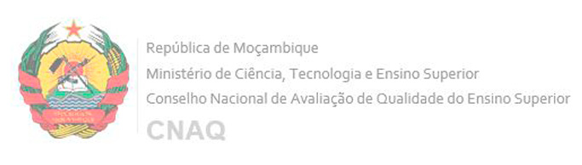


Strategic partners

Slide 3




Youth Mobility for Africa
The flagship initiative on Youth Mobility for Africa promotes opportunities for learning mobility on the continent and between Africa and the EU.
It supports cooperation in higher education and skills development, strengthens regional and continental harmonisation mechanisms, while promoting Africa as a study destination. Thereby, the initiative contributes to youth empowerment for sustainable employability and active citizenship.
The Youth Mobility for Africa flagship initiative is part of the Global Gateway Africa-Europe Investment Package.

Slide 4
Data Governance for Higher Education Management Information Systems in Africa

Slide 5
The Criticality of Data in African HE
The effective use of data can transform institutional performance and relevance:
Evidence-Based Decision-Making: Supports the planning and execution of strategic initiatives, leading to more informed and effective decisions.
Enhancing Educational Outcomes: Helps to identify at-risk students, tailor support services, and ultimately improve retention and graduation rates.
Curriculum and Relevance: Aligning academic programs with labor market demands, ensuring graduates possess the skills needed for employment in emerging sectors, addressing the high youth unemployment challenge.
Benchmarking and Quality Assurance: Essential for participation in continental and global quality assurance initiatives (e.g., AQRM, PASET), which strengthens institutional self-assessment and performance.

Slide 6
The Criticality of Data in African HE (contd)
Resource Optimisation: Enables HEIs to track funding, manage budgets and optimize resource allocation across various departments and programs.
Addressing Social Justice and Equity: Monitoring and addressing issues of inclusion and equity, tackling systemic biases and promoting fair practices.
Fostering Research Integrity and Innovation: FAIR principles (Findable, Accessible, Interoperable, Reusable), are crucial for high-profile research projects and meeting international funding requirements.
Digital Sovereignty in the Age of AI: Foundation for developing and training localised Artificial Intelligence (AI) models that are culturally and linguistically relevant to Africa, moving HEIs from being mere consumers of foreign technology to creators of sovereign AI capacity

Slide 7
The Criticality of Data in African HE (contd)
Resource Optimisation: Enables HEIs to track funding, manage budgets and optimize resource allocation across various departments and programs.
Addressing Social Justice and Equity: Monitoring and addressing issues of inclusion and equity, tackling systemic biases and promoting fair practices.
Fostering Research Integrity and Innovation: FAIR principles (Findable, Accessible, Interoperable, Reusable), are crucial for high-profile research projects and meeting international funding requirements.
Digital Sovereignty in the Age of AI: Foundation for developing and training localised Artificial Intelligence (AI) models that are culturally and linguistically relevant to Africa, moving HEIs from being mere consumers of foreign technology to creators of sovereign AI capacity

Slide 8
The importance of Data Governance
Ensuring Data Quality and Integrity
Regulatory Compliance and Security
Promoting Data Sovereignty
Building Stakeholder Trust and Transparency
Enabling Data Sharing and Collaboration
Establishing Ethical Mandates

Slide 9
Definition of Data Governance
‘‘…the principles, procedures, frameworks, and policies that ensure acceptable and responsible processing of data at each stage of the data life cycle, from collection, storage, processing, curation, sharing, and use to deletion’’
Eke et al., 2021 https://www.sciencedirect.com/science/article/pii/S0896627321009557

Slide 10
DG Framework
Technology for…
Metadata standardization
To protect the privacy and confidentiality of data subjects
For data security
For data sharing
People, Processes and Technology (PPT) Framework
People
Who owns the data?
Who is the data controller(s)
Who is responsible in cases of breach?
Who are the data subjects?
Do you need to create new positions/roles for data governance?
Processes for …
For data collection (e.g consent)
For data processing (e.g anonymisation)
For data application
For data sharing
For Storage and deletion
Quality Assurance

Slide 11

THANK YOU!
More information at
www.haqaa3.obreal.org

