Slide 2
MODULE 2 - “TRANSFER”
Understanding, using as a basis an analysis of the effective operation of the European Credit Transfer System (ECTS), how a credit system can be used as an instrument to facilitate student mobility.
Promoting the reflection on existing and possible future practices of student mobility at the African continental and regional level.

Slide 3
Overview
Welcome and introduction
Regional CTS: state of play and implementation, Reflections on existing intra-African mobility juxtaposed with other types of international mobility, Regional mobility schemes (SARUA/SADC)
Case studies
Student perspective
Discussion on own institutional experiences
Looking ahead

Slide 4
PART 1:
Regional perspectives on mobility and credit transfer

Slide 5
Perspectives
Regional CTS: state of play and implementation, Reflections on existing intra-African mobility juxtaposed with other types of international mobility, Regional mobility schemes (SARUA/SADC)
Case studies
Student perspective

Slide 6
PART 2:
Reflection activities and collective discussion

Slide 7
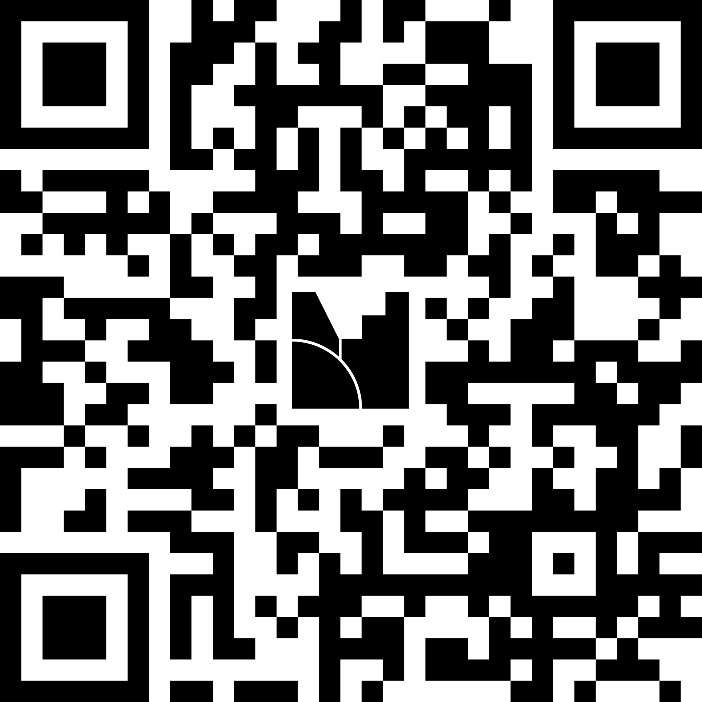

Slide 8
Observations and findings from activities
INSTITUTIONAL LEVEL
Mobility is possible in PRINCIPLE, implementation is difficult
Postgraduate mobility is easier
Lack of intentionality in internationalisation of the curriculum design and development)
Distrust
NATIONAL LEVEL
Lack of data (national level)
Distrust

Slide 9










Strategic partners

Slide 10

THANK YOU!
More information at
www.haqaa3.obreal.org

