Slide 2
Latin America and the Caribbean: experiences and challenges in the standardization and integration of higher education information
Leticia Mirás
July 2026

Slide 3
CONTENTS
Integrating information at the regional level
The Argentine national case
The experience in Latin America

Slide 4
INTEGRATING INFORMATION AT THE REGIONAL LEVEL
The integration of information at the regional level requires standardization processes, which allow us to understand:
  What information is collected in each country—that is, which indicators are available and which data sources are used
  which conceptual definitions underpin those indicators
  which indicators are comparable
What do we lose through integration:
  the specificities of each national reality
  the greater the aggregation, the less detail
  this is always the case in the systems of comparative indicators
  institutional detail cannot be fully replaced at the national, regional or international level.

Slide 5
INTEGRATING INFORMATION AT THE REGIONAL LEVEL
Uses and advantages of comparative information
Comprehensive view of the region
Helps place national systems in perspective through comparison with neighbouring countries,
System assessment
Measurement of quality, recognising that quality is a multidimensional and context-dependent concept.
Information for institutioal management and decision-making
information for education policy decision-making.

Slide 6
INTEGRATING INFORMATION AT THE REGIONAL LEVEL
National requirements
Integration of information from higher education institutions
Tensions between institutional management information systems and integrated national information systems
Standardization of variables and definitions
In addition to the conceptual definitions, there are the operational definitions

Slide 7
NATIONAL CASE: ARGENTINA
Binary, non-integrated HE system
two types of higher education institutions: non-university institutions and universities
Different form of organization, creation, regulations and governance
Dissimilar centralization of information at the national level
Non-university HEIs: 2.731
Universities: 137
3.736.656: students
75,28% students in public institutions
63.5% women
75,23% gross enrolment rate

Slide 8
NATIONAL CASE: ARGENTINA
Long-standing national information system: almost 50 years of standardization of conceptual definitions.
Progressive construction of an integrated collection system.
The University Information System (SIU) developed management software and management systems that provided information at the national level.

Slide 9
NATIONAL CASE: ARGENTINA
LEARNINGS
It was necessary to integrate dispersed information within the same ministry.
From a country's point of view, it is necessary to reflect on the adaptations required by its own systems.
Regional integration requires reviewing categories, definitions and collection mechanisms.

Slide 10
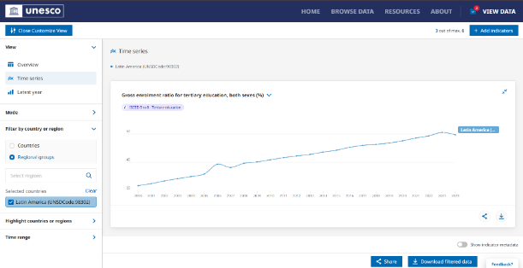

GLOBAL INDICATORS
UIS – UNESCO
OECD

Slide 11
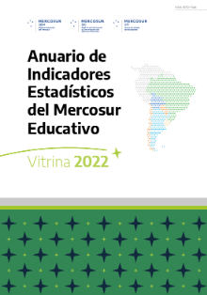
REGIONAL INDICATORS
Mercosur Educational Sector

Slide 12
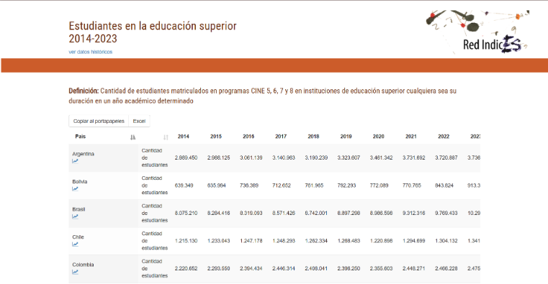
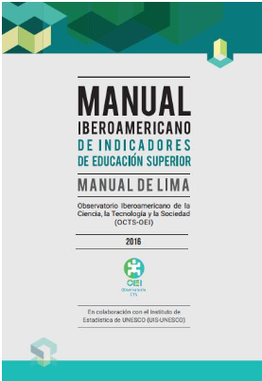
INDICADORES RREGIONAL INDICATORSEGIONALES
The Ibero-American Network of Higher Education Indicators (INDICES)
and
Lima Manual

Slide 13
REGIONAL INDICATORS
CONCLUSIONS
UIS and OECD: International comparison with internationally standardized definitions
Limited ability to capture regional specificities
Mercosur Education Sector and INDICES Network: more integration
Collective, bottom-up approach, consensus and discussion on comparable aspects.
Richer and more useful results for policy and academic research
The experience of the Lima Manual
Integrates information based on collectively agreed definitions and comparable indicators.
It allows us to think about regional integration without losing sight of national and regional specificities

Slide 14

THANK YOU!
More information at
www.haqaa3.obreal.org

