Slide 2










Strategic partners

Slide 3




Youth Mobility for Africa
The flagship initiative on Youth Mobility for Africa promotes opportunities for learning mobility on the continent and between Africa and the EU.
It supports cooperation in higher education and skills development, strengthens regional and continental harmonisation mechanisms, while promoting Africa as a study destination. Thereby, the initiative contributes to youth empowerment for sustainable employability and active citizenship.
The Youth Mobility for Africa flagship initiative is part of the Global Gateway Africa-Europe Investment Package.

Slide 4
HEMIS Capacity Building Programme: Case Study of a Regional HEMIS System – Southern African Development Community (SADC)
Prepared by Dr Charles Sheppard

Slide 5
Background to the development of the SADC Higher Education Database
SADC Ministers, at their joint meeting of Education and Training and Science, Technology and Innovation, in 2019, endorsed that a comprehensive profile and database of Higher Education for the SADC Region should be developed.
Requirements:
  Include public and private education sectors.
  Developed in consultation with all key stakeholders in the region.
  Development in a phased approach.
  Complement existing databases.
  In long term should contains data at institutional, national and regional level.
  Access as an open-source database.
Goals and usefulness:
  Regional data for informed policy decisions.
  Evidence planning in support of regional integration.
  Shared understanding of role of higher education in national and regional development.
  Assist private sector in economic forecasting – Human Resources Potential of the region

Slide 6
Achievements and data collected through the templates

Slide 7
Achievements and data collected through the templates
Due to various obstacles the project only commenced in July 2024.
Higher Education Indicators have been identified and defined. The method of calculation has been defined and the data needed for the calculation of the indicators have been identified.
Master list of institutions template has been developed
Classification systems have been agreed upon.
Data collection templates have been developed.
A survey has been developed to determine:
  Collection processes at national level in countries
  Identify the agencies responsible for the collection of the data at national level
  Contact details of responsible officials
  Data elements that are available at national level needed for the completion of the data templates.
Notes have been compiled for the completion of the surveys and data collection templates

Slide 8
Achievements and data collected through the templates
  The templates collect the following data:
  Enrolments and graduates by sub-field of study (ICED), qualification type and gender.
  International student enrolments by country (UN classification system).
  Academic staff data by appointment type (permanent and temporarily).
  Permanent academic staff by highest qualification and rank.
  International staff by country
  Public and private university data are collected separately
  Indicators were selected from UNESCO’s higher education indicators and indicators were added that can be calculated from the data that will be collected.
  Template for the collection of data needed to establish a Master list of Higher Education Institutions was developed. This will have to be updated quite regularly.

Slide 9
Achievements and data collected through the templates
Inputs from country representatives were received at the SADC EMIS Technical Committee that was held on the 7th and 8th of August 2024 in Mauritius in August 2024 and were applied to the documents and templates.
The templates, definitions, and classification lists were distributed to countries following the workshop for further inputs and refinement.
With the support of OBREAL Global and UNESCO the gap analysis has been completed and the pilot data collection have been completed.
The gap analysis has been completed, and responses were received from Botswana, Eswatini, Lesotho, Mauritius, Namibia, Seychelles, South Africa, Zambia and Zimbabwe. The final report is available
The data templates for the data collection were also send out for the first collection and data in the format that the countries had available were received from Botswana, Eswatini, Mauritius, Namibia, Seychelles, South Africa Zambia and Zimbabwe.

Slide 10
Next steps in the development of the SADC database
Statistical report will be developed to provide an overview of the higher education systems in the countries that provided data in the first round of data collection (Updated every two years)
More countries will be added to each consecutive update of the data. The request for the update of the data (adding an additional two years – 2024 and 2025 or 2024/25 and 2025/2026 will go out shortly once the templates have been updated.
Project will require adequate funding for the development of a usable data base, necessary capacity at higher education institutional level as well as national level to provide reliable data and ensure a sustainable data flow.
The possibility of housing the database at the SADC Secretariat will be explored because of there very efficient communication system and contact within the SADC countries
Additional data that can be added in future is variables on research and innovation: Research Publications, Research Institutes/ Centres of Excellence/ Centres of Specialisation.
The inclusion of student success indicators will be explored.

Slide 11
Conclusions and recommendations from the GAP Analysis Report on the mapping of the state of play of higher education data systems.

Slide 12
Gap analysis conclusions and recommendations
Most of the countries collect data at a national level through data submissions with Excel Workbooks. It is recommended that countries should consider the submission of institutional data through the transfer of electronic data sets in prescribed file formats. . It will be a costly exercise for countries to develop electronic uniform data set transfers, but it would be the way to go in the long term.
Capacity needs to be developed at the SADC secretariat with a capability to upload completed excel workbooks which could then be read into a database and linked to uniform identifiers in the datasets to enable reports to be generated. The cost of developing such a capability needs to be determined and funded. It will also need human capacity apart from software development for updating, quality assurance and maintenance of the database. Data specifications and data definitions would have to be developed for the database.
Updating the database on an annual basis to ensure that it does not become outdated will be crucial.
This work will have to be taken forward by a permanent capacity at the SADC secretariat.

Slide 13
Gap analysis conclusions and recommendations
One of the biggest obstacles to produce comparable data sets at this stage is that most countries have their own classification systems for field of study and only a few countries classify down to sub-field of study. It is recommended that countries retain their own classification systems because they have developed their reporting based on these systems, but that additional fields be added to each qualification record to add the field and sub-field classification of the ISCED classification system.
Most countries do not classify their permanent academic staff members according to fields of study and in such a case the data variable and need for it to be collected will have to be revisited.
The first round of data collection aimed to only collect data at aggregated national level and discussions will be needed on the viability and need to collect data at institutional level, which will involve a much more elaborate exercise.
This will have to be considered in liaison with the agencies responsible for the collection of higher education data at national level.

Slide 14
A few examples of data analyses on the data submitted

Slide 15
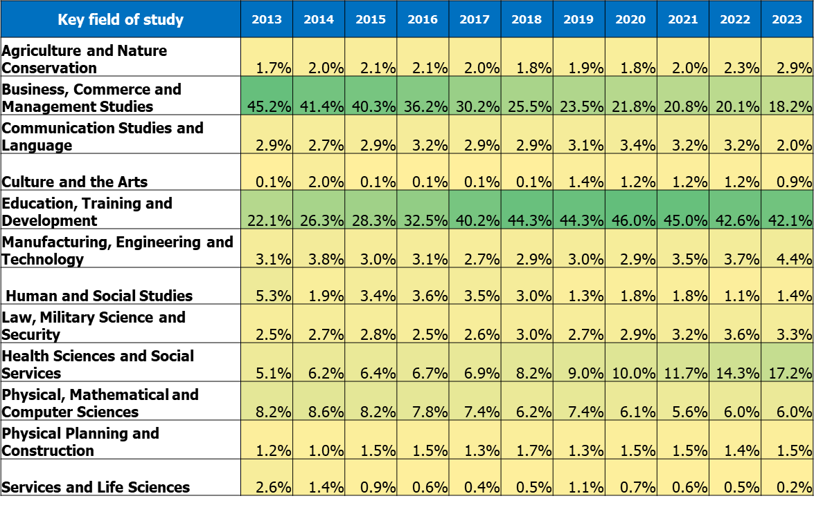
Namibia: Changes in enrolments by field of study, 2013 - 2023

Slide 16
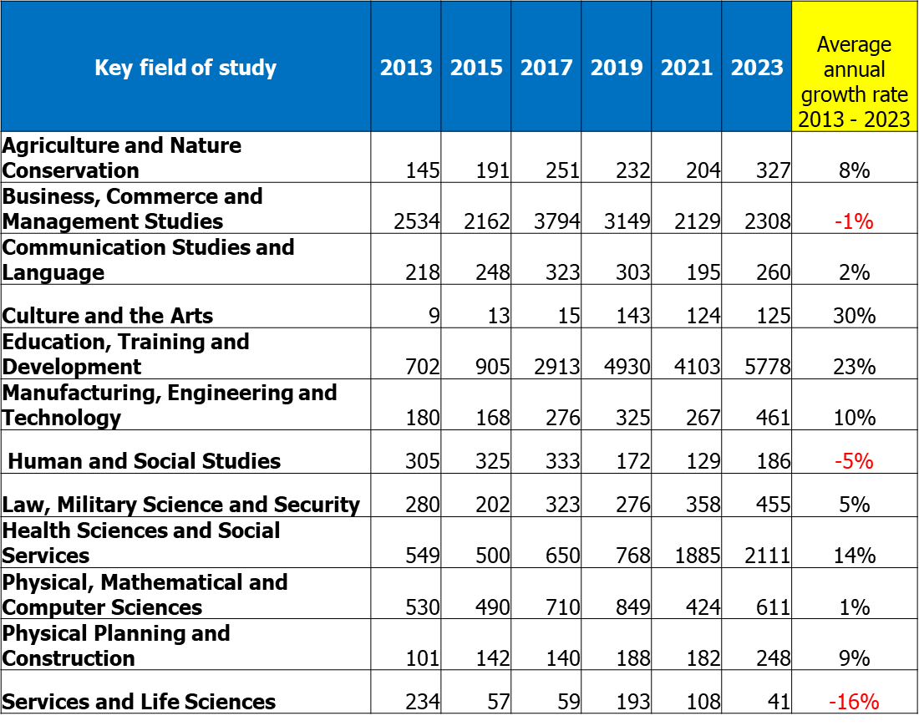
Namibia: Graduates 2013 to 2023 and the average annual growth rate, 2023 - 2023

Slide 17
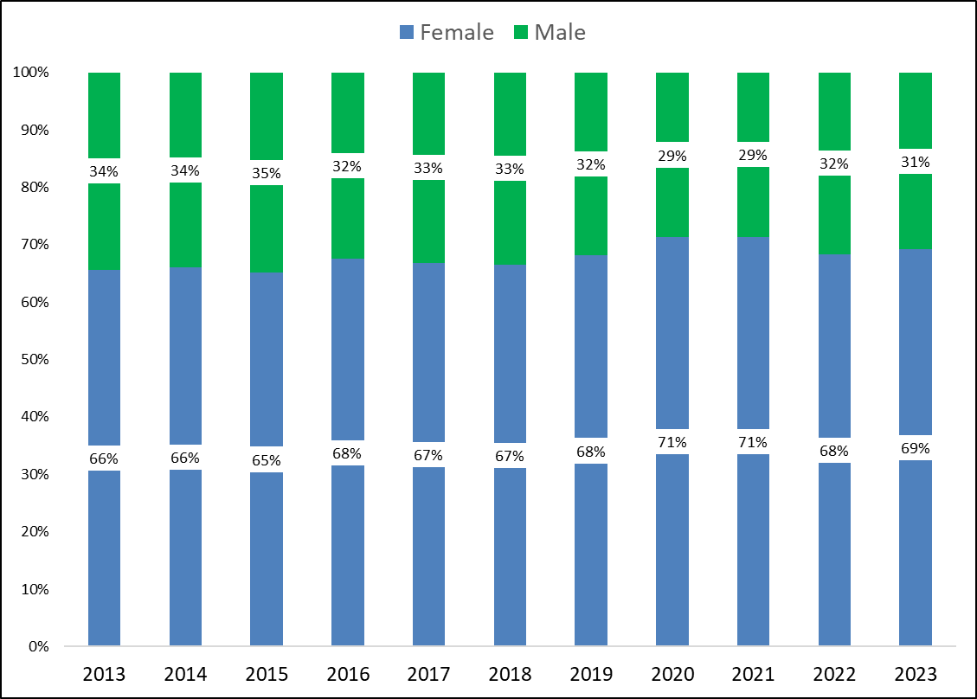
Namibia: Gender distribution of graduates, 2023 to 2023

Slide 18
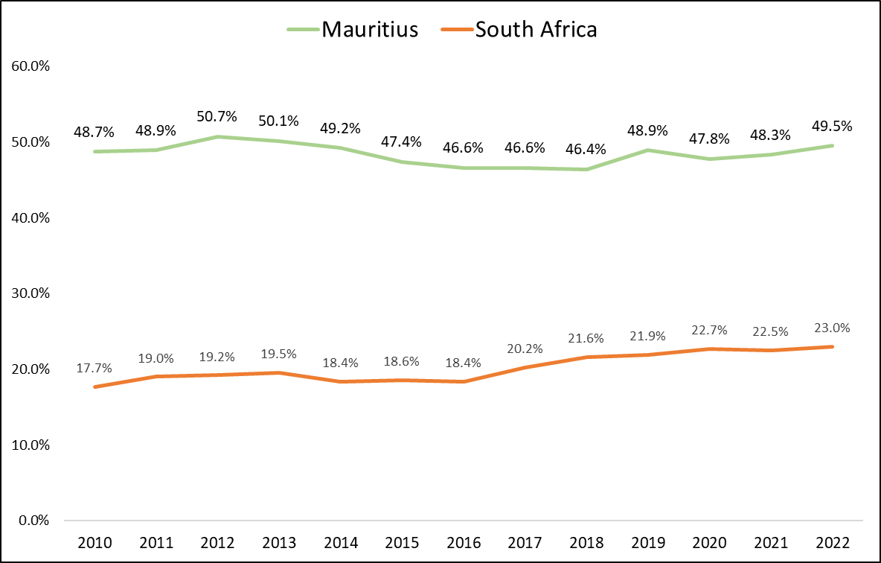
Mauritius and South Africa: GER 2022
Participation in higher education (HE): Gross Enrolment Ratio (GER). The GER for HE is the total headcount enrolment (regardless of age) over the population numbers in the 20 to 24-year age category.

Slide 19
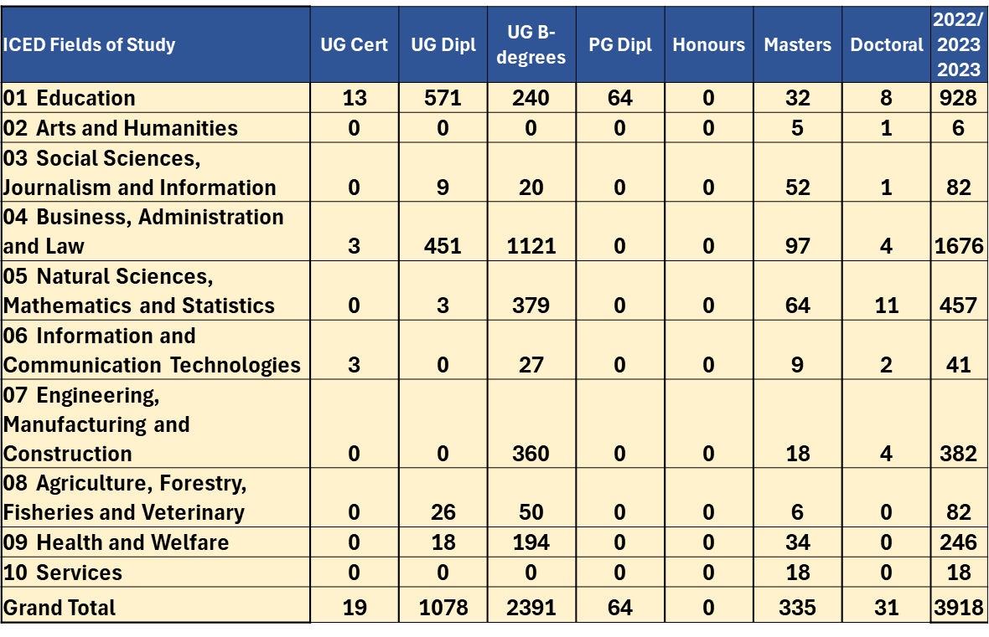
Botswana Public Universities: Graduates by ISCED Field of Study, 2022/2023 or 2023

Slide 20
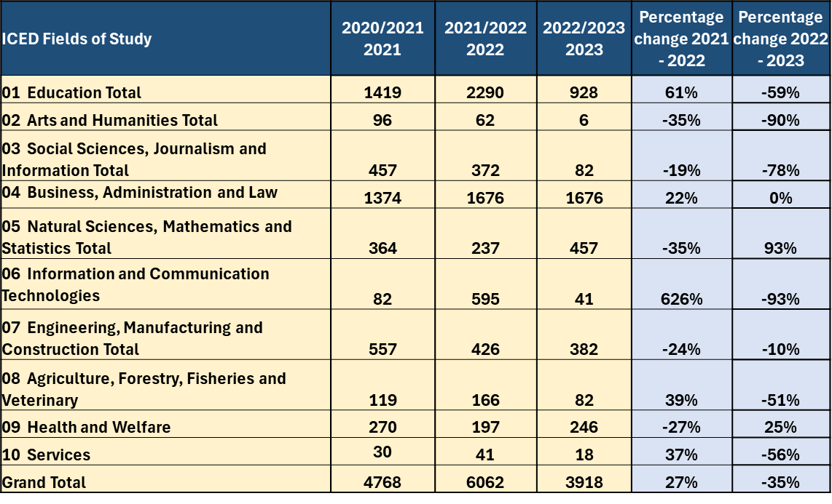
Botswana Public Universities: Graduates by ISCED Field of Study, 2021 to 2023

Slide 21
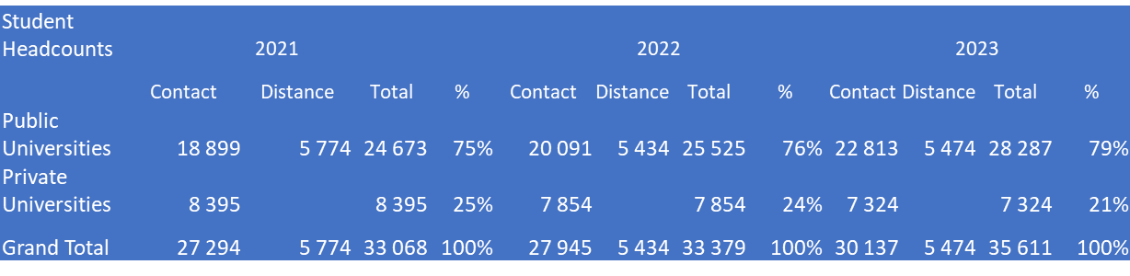
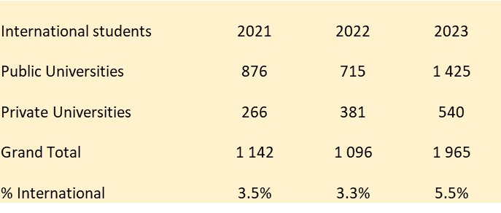
Botswana: Enrolments in Public and Private Universities and International Enrolments, 2021 - 2023

Slide 22
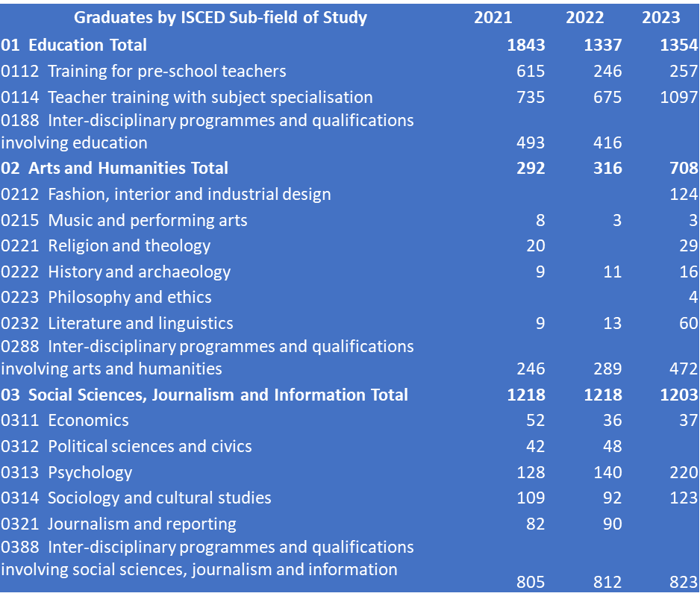
Great Zimbabwe University graduates by ICED sub-field 2021 - 2023

Slide 23
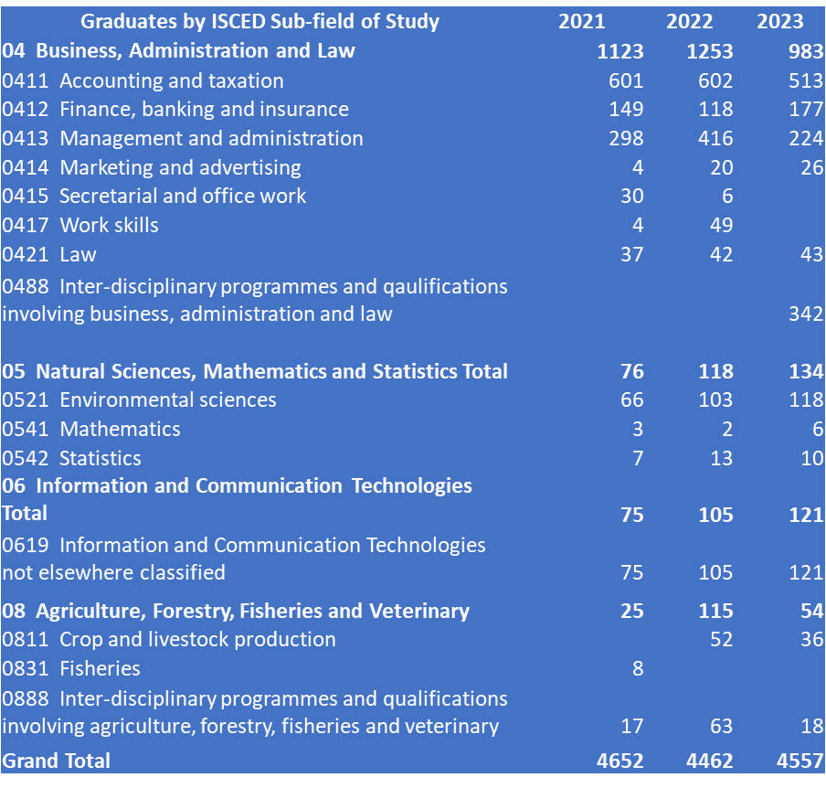
Great Zimbabwe University graduates by ICED sub-field 2021 - 2023

Slide 24
Great Zimbabwe Academic Staff by Highest Qualification and Rank, 2021 - 2023
 | Headcounts |  |  | Headcounts |  |  | Headcounts
 | 2021 |  |  | 2022 |  |  | 2023
 | Female | Male | Total | Female | Male | Total | Female | Male | Total
Professors | 3 | 13 | 16 | 3 | 16 | 19 | 3 | 16 | 19
Associate professors | 4 | 16 | 20 | 4 | 21 | 25 | 3 | 20 | 23
Senior lecturers | 12 | 57 | 69 | 12 | 60 | 72 | 16 | 89 | 105
Lecturers | 70 | 205 | 275 | 90 | 215 | 305 | 79 | 176 | 255
Total | 89 | 291 | 380 | 109 | 312 | 421 | 101 | 301 | 402

Slide 25
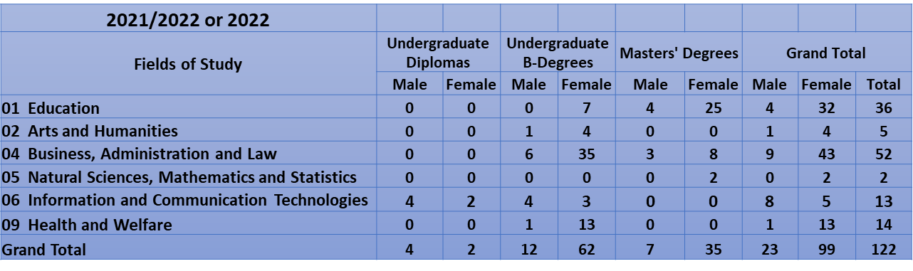
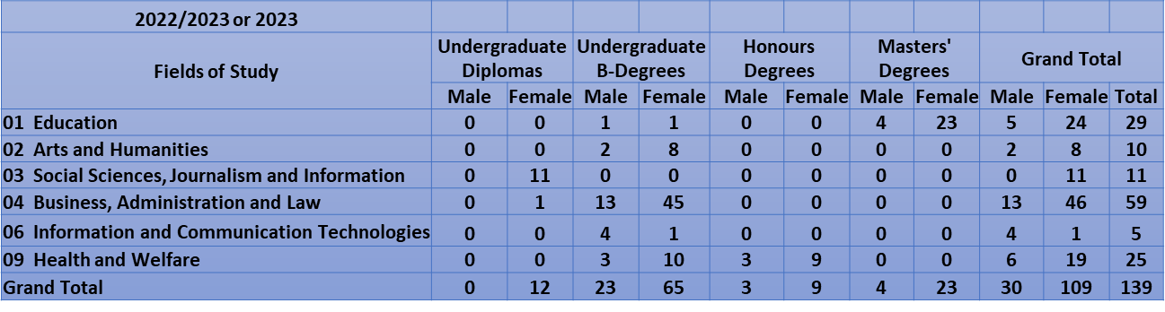
University of Seychelles , Graduates in 2022 and 2023 by ISCED Field of Study

Slide 26
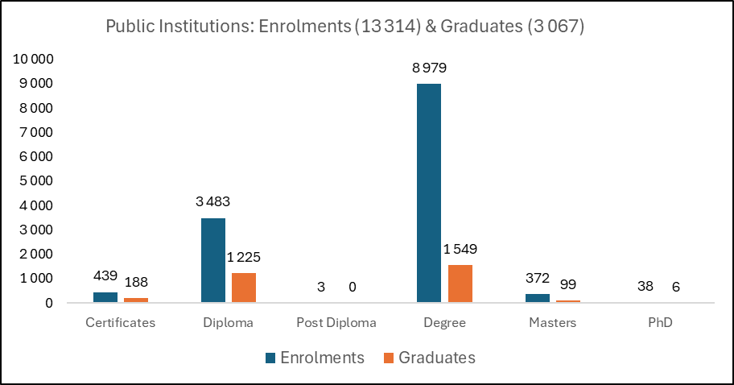
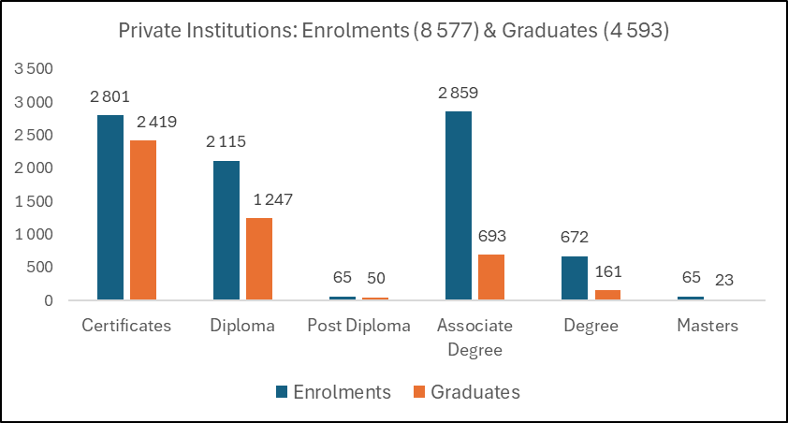
Eswatini: Enrolments and Graduates in Public and Private Institutions, 2023

Slide 27
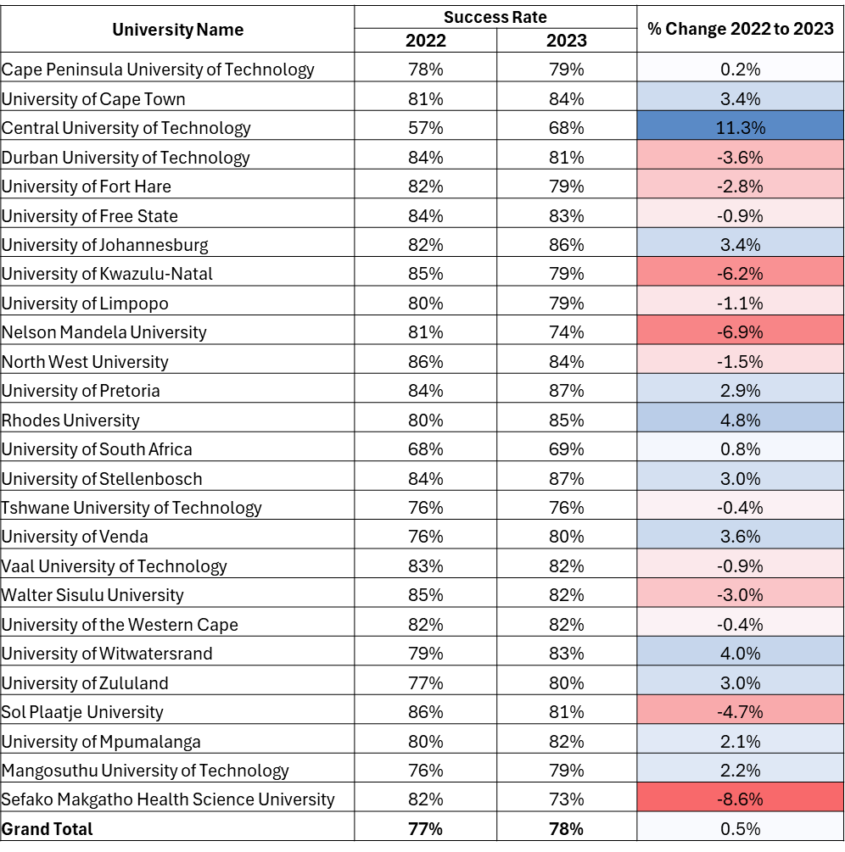
South Africa Public Universities: Changes in student success rates, 2022 to 2023

Slide 28
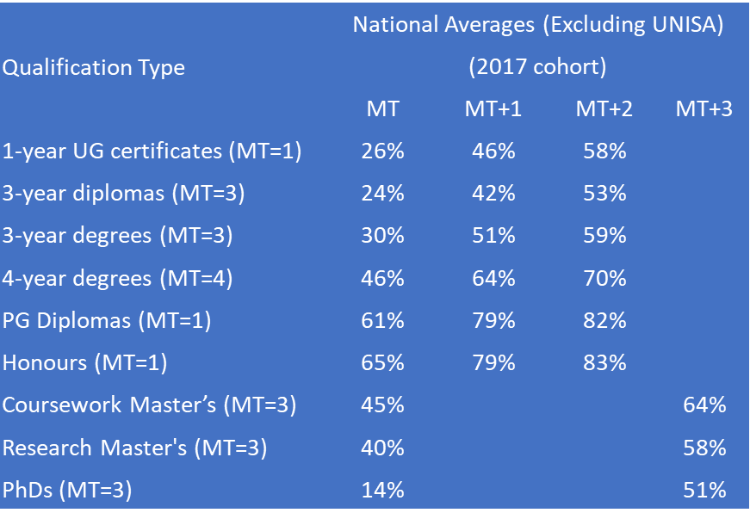
South Africa: Throughput rates, 2017 Cohort (Excluding UNISA)

Slide 29
Zambia: Graduates according to ISCED field, 2024
Field of study | Graduates | % of Total
01 Education | 4515 | 15.7%
02 Arts and humanities | 1219 | 4.2%
03 Social sciences, journalism and information | 956 | 3.3%
04 Business, administration and law | 3221 | 11.2%
05 Natural sciences, mathematics and statistics | 780 | 2.7%
06 Information and communication technologies | 880 | 3.1%
07 Engineering, manufacturing and construction | 990 | 3.4%
08 Agriculture, forestry. Fisheries and veterinary | 220 | 0.8%
09 Health and Welfare | 15803 | 55.0%
10 Services | 145 | 0.5%
Not Known of unspecified | 0 | 0.0%
Total: All fields of education | 28729 | 100.0%

Slide 30
Performance indicators

Slide 31
Performance indicators
  Higher Education indicators that can be developed from the data templates:
  UNESCO Indicators:
  Higher Education Gross Enrolment Ratio (GER).
  Total public expenditure on public higher education (current and capital) expressed as a percentage of Gross National Income (GNI). GNI is also referred to as the Gross National Product (GDP).
  Public current expenditure per student as % of Gross National Income (GNI) per capita. GNI is also referred to as Gross National Product (GNP).
  Percentage distribution of students in higher education by ISCED sub-fields of education.
  Percentage distribution of graduates in higher education by ISCED sub-fields of education.
  Percentage enrolment in private higher education institutions.
  Percentage of academic staff in private higher education institutions.

Slide 32
Performance indicators
  Additional Higher Education Indicators that can be developed from the data collected:
  Percentage international students in higher education.
  Percentage international academic staff in higher education.
  Percentage academic staff by sub-field of education.
  Percentage academic staff by highest qualification.
  Percentage academic staff by rank.

Slide 33
Performance indicators
Source of definitions and method of calculation: UNESCO Institute for Statistics (2009). Education Indicators Technical Guidelines
1. UNESCO Higher Education Indicators that can be calculated from the data collected for the SADC Higher Education Data Base
Indicator | Definition | Formula | Purpose
Higher Education Gross Enrolment Ratio (GER). | Total enrolment in higher education, regardless of age, expressed as a percentage of the eligible population corresponding to higher education. | GER=(Enrolments in higher education in university year n /Population in age group corresponding to higher education in year n)*100 | It shows the general level of participation in higher education. It indicates the capacity of the higher education system to enrol students of the age group eligible for higher education.
Total public expenditure on public higher education (current and capital) expressed as a percentage of Gross National Income (GNI). GNI is also referred to as the Gross National Product (GDP). | Public Expenditure on public Higher Education as % of Gross National Income (GNI) in a given financial year. | Percentage public expenditure on public higher education in financial year n = (Total public expenditure on public higher education in financial year n/GNI in financial year n)*100 | Proportion of GNI of a given financial year that has been spent by government authorities on public higher education.
Public current expenditure per student as % of Gross National Income (GNI) per capita. GNI is also referred to as Gross National Product (GNP). | Public current expenditure per student expressed as a percentage of GNI per capita in a given financial year. | Public current expenditure per student in public higher education as a percentage of GNI per capita in the financial year n = ((Public current expenditure on public higher education in year n/ Total enrolment in public higher education in year n)/(Gross National Product in financial year n/Total population in year n))*100. | To measure the share of per capita income spent on each student in public higher education and it helps in assessing a country's level of investment in human capital.

Slide 34
Performance indicators
Indicator | Definition | Formula | Purpose
Percentage distribution of students in higher education by ISCED sub-fields of education. | Enrolment in each ISCED sub-field of education at higher education level, expressed as a percentage of the total enrolment in higher education. | Percentage of students enrolled in sub-field of education f in academic year n = (Number of students enrolled in sub-field of education f in academic year n/ Total enrolment in higher education in year n)*100. | To gauge the level of development of higher education in terms of the range of sub-fields offered, the capacity in each sub-field as well as student preferences, thus reflecting both the potential demand and supply of qualified human resources in different specialisations.
Percentage distribution of graduates in higher education by ISCED sub-fields of education. | Graduates in each ISCED sub-field of education at higher education level, expressed as a percentage of the total number of graduates in higher education. | Percentage of students graduating from the sub-field of education f in academic year n = (Number of students graduating from the sub-field of education f in academic year n/ Total number of graduates in higher education in year n)*100. | To show the distribution of higher education graduates over different sub-fields of education. It also reflects the development of higher education in terms of the range of sub-fields offered as well as the supply of qualified human resources in different specialisations.
Percentage enrolment in private higher education institutions. | Enrolment in private higher education institutions expressed as a percentage of total higher education enrolment. | Percentage of students enrolled in private higher education institutions in academic year n = (Number of students enrolled in private higher education institutions in academic year n/ Total number of enrolments in public and private higher education institutions in year n)*100. | To measure the relative weight of private higher education in terms of enrolment, hence the scale and capacity of private higher education within a country.
Percentage of academic staff in private higher education institutions. | Number of academic staff in private higher education institutions expressed as a percentage of the total academic staff in public and private higher education institutions. | Percentage of academic staff in private higher education institutions in academic year n = (Number of academic staff in private higher education institutions in academic year n/ Number of academic staff in public and private higher education inctitutions in academic year n)*100. | To measure the relative weight of private higher education in terms of academic staff.

Slide 35
Performance indicators
2. Additional Higher Education Indicators that can be developed from the data collected
Indicator | Definition | Formula | Purpose
Percentage international students in higher education. | Number of international students in higher education expressed as a percentage of total enrolled students in higher education. | Percentage of international students in higher education institutions in academic year n = (Number of international students in higher education institutions in academic year n/ Number of all students in higher education institutions in academic year n)*100. | To measure the relative weight of international student enrolments in higher education.
Percentage international academic staff in higher education. | Number of international academic staff expressed as a percentage of total academic staff. | Percentage of international academic staff in higher education institutions in academic year n = (Number of international academic staff in higher education institutions in academic year n/ Number of all academic staff members in higher education institutions in academic year n)*100. | To measure the relative weight of international academic staff in higher education.
Percentage academic staff by sub-field of education. | Academic staff in each ISCED sub-field of education at higher education level, expressed as a percentage of the total number of academic staff in higher education. | Percentage of academic staff in each sub-field of education in academic year n = (Number of academic staff in each sub-field in higher education institutions in academic year n/ Number of all academic staff members in higher education institutions in academic year n)*100. | To show the distribution of academic staff over different sub-fields of education. It also reflects the supply of academic staff across the various sub-fields of education and can be compared to the students enrolled in these sub-fields.

Slide 36
Performance indicators
Indicator | Definition | Formula | Purpose
Percentage academic staff by highest qualification. | Academic staff in each qualification type (doctorate, masters, other) expressed as a percentage of the total number of academic staff in higher education. | Percentage of academic staff in each qualification type in academic year n = (Number of academic staff in each qualification type in higher education institutions in academic year n/ Number of all academic staff members in higher education institutions in academic year n)*100. | To show the distribution of academic staff according to highest qualification and it also shows the supervisory capacity of staff for postgraduate students.
Percentage academic staff by rank. | Academic staff in each rank (professors, associate professors, senior lecturers, lecturers) expressed as a percentage of the total number of academic staff in higher education. | Percentage of academic staff in each rank in academic year n = (Number of academic staff in each rank in higher education institutions in academic year n/ Number of all academic staff members in higher education institutions in academic year n)*100. | To show the distribution of academic staff according to rank and it also shows the seniority of academic staff in the higher education system.

Slide 37

THANK YOU!
More information at
www.haqaa3.obreal.org

